Slide 1
Do Now
Pick up a Big Bang Theory Reading & Guide
Begin reading & answering the questions as you go
You have 10 minutes from the bell to complete
This will be handed in for a class work grade
This is to gear you up for our Big Bang Lesson

Slide 2
Agenda
Objective
SWBAT outline Big Bang Theory as it relates to the expanding universe & astronomical hierarchy
Do Now
Class Work Grade
Objective
Guided Notes & Videos
Big Bang Balloon Lab
Lab Report Grade
Exit Ticket
Homework
Hubble’s Expanding Universe Reading & response
Due Friday
(Tomorrow)

Slide 3
Student Faculty Basketball Game
Are you going??
Come support Habitat for Humanity & ME
I will be playing in the game tomorrow
I played soccer & basketball in high school
I won 3 basketball champion ships & 2 in soccer
I played soccer in college my freshman year before tearing my ACL

Slide 4
Faculty Basketball Practice
I have basketball practice this afternoon @ 230
Unfortunately I need to cancel tutoring until next week. I will be available for extra tutoring hours next week:
Tuesday, Wednesday, Thursday

Slide 5
Unit 2 Astronomy Disclaimer
You may not agree with theories
a supposition or a system of ideas intended to explain something, esp. one based on general principles independent of the thing to be explained.
Religion may disagree but science & religion are two very different realms of thought
Unfortunately- I am not an astronomer
I may not be able to answer all questions
Especially the whys? And hows?
As we saw in the video yesterday- it took lots of time, observations & theory adaptations to find some truth about the beginning of time & space
I want to help you find answers to your questions but we have an objective for our lesson that we cannot lose sight of

Slide 6
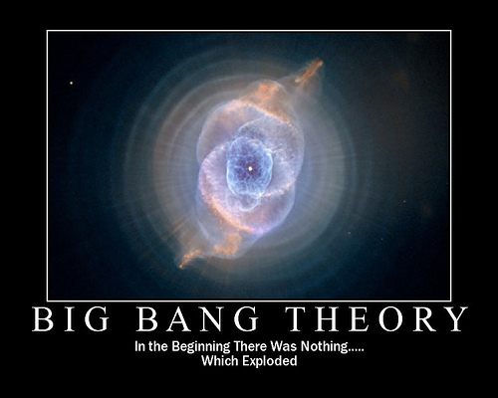
The Formation of the Universe

Slide 7
Big Bang Theory... The show?
http://www.youtube.com/watch?v=e0p04CLd0gk
Shout Out to Issac Cook for recommending this!

Slide 8
Big Bang Theory
At one time, the universe was a dense, hot, supermassive ball.
About 13.7 billion years ago, a violent explosion occurred sending material in all directions into space.

Slide 9
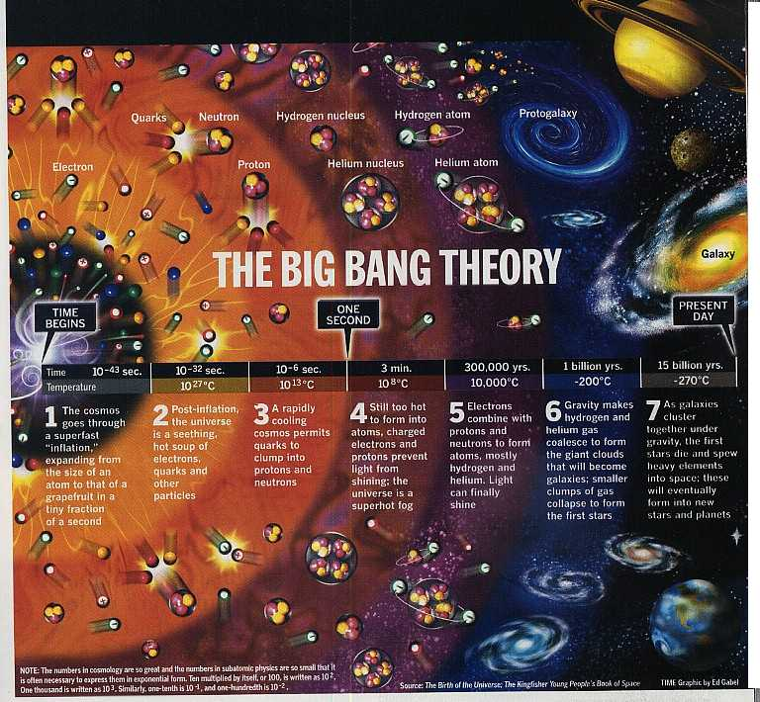
This marked the beginning of the universe.
Eventually, matter cooled and condensed into galaxies, stars, and planets.

Slide 10
Video Time
Discovery Ed:
http://app.discoveryeducation.com/search?Ntt=big+bang+theory
Notes:
Revolution Model:
http://www.classzone.com/books/earth_science/terc/content/visualizations/es0408/es0408page01.cfm?chapter_no=visualization
Revolution Model:
http://www.classzone.com/books/earth_science/terc/content/visualizations/es0408/es0408page01.cfm?chapter_no=visualization

Slide 11
1. The Beginning- An Explosion
14 billion years ago a tightly packed, very dense, high temperature singularity exploded.
The Big Bang

Slide 12
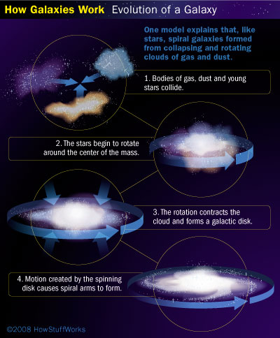
2. Galaxies Form
All the elements that were bundled up in the ball spread, expanded and grew and over time, the galaxies were formed.

Slide 13
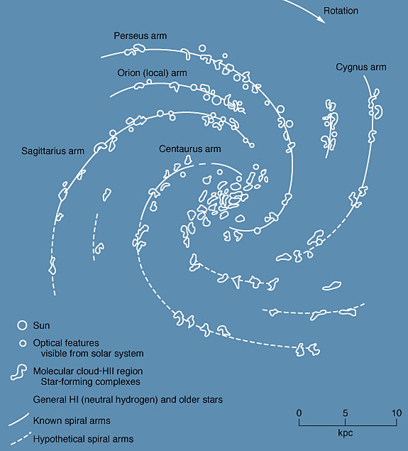
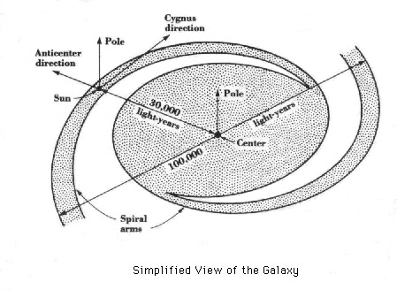
3. Our Galaxy
In our galaxy only cold, dark gas and dust were spread throughout.

Slide 14
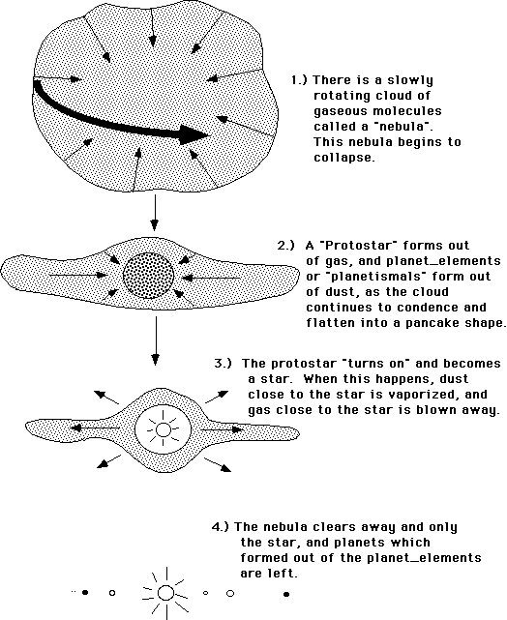
4. Solar Systems Form
About 5 billion years ago a giant cloud of dust (nebula) in our galaxy collapsed to form an early version of the solar system

Slide 15
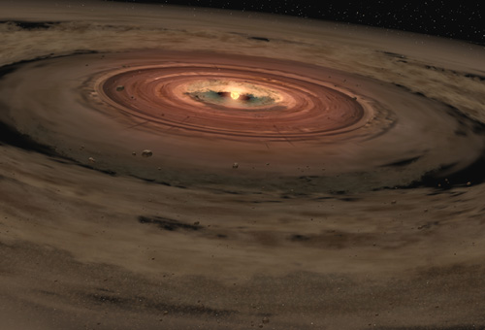
5. The Spinning Disk
Over the course of millions of years, gravity began to pull the elements of the nebula together (mostly helium and hydrogen) until clumps formed. The cloud also began to spin with the biggest clump in the center.

Slide 16
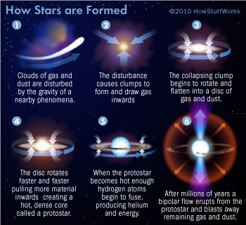
6. Sun Forms
The pressure caused by gravity forces gas to come together and causes nuclear fusion reactions, setting the core on fire, and the sun was born.

Slide 17
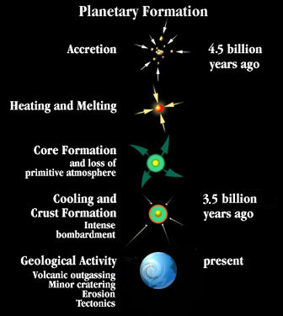
7. Planets Form
The remaining clumps of gas and dust became planets. Planets closer to the sun lost its gas and became hunks of rock. They are known as terrestrial planets (inner planets) and the other planets became big hunks of gas known as gas giants (outer planets).

Slide 18
Solar Nebula
Cloud of dust and particles (solar nebula) created the planets in our solar system.

Slide 19
Expansion from Explosion

Slide 20
Galaxy Formation
Look for which 7 steps are demonstrated in this quick demonstration
http://www.youtube.com/watch?v=n0jRObc7_xo

Slide 21
But how do we know about the Big Bang?

Slide 22
The Expanding Universe
1929 – Edwin Hubble found that the universe is expanding
Proof comes from Red Shifts: meaning wavelengths of light from other Galaxies are becoming longer and redder
This proves these galaxies are moving Away from us

Slide 23
Red Shift Analogy
Raisin Bread
Uncooked raisins are closer together
When bread is baking the bread rises & raisins become more spread out
This is the same for the expanding universe
Planets are staying stationary but can tell that things are moving away from them
This proves the entire universe is expanding

Slide 24
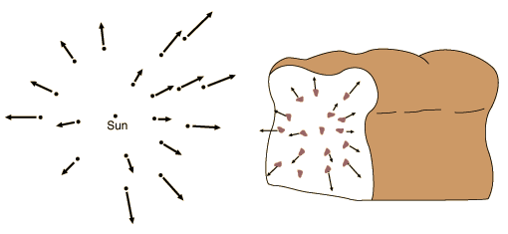
each raisin will see all other raisins moving away from it as the loaf expands

Slide 25
Again... Red Shift Analogy
Raisin Bread
Uncooked raisins are closer together
When bread is baking the bread rises & raisins become more spread out
This is the same for the expanding universe
Planets are staying stationary but can tell that things are moving away from them
This proves the entire universe is expanding

Slide 26
Support for the Big Bang Theory
Cosmic background radiation
Radio signals coming from every direction in space.
Believed to be created by the big bang explosion.

Slide 27
Large bodies in the solar system have orderly motions
All planets orbit sun in a Counter Clockwise motion
All planets rotate in a Counter Clockwise motion (except Venus)
The Sun rotates in the same Counter Clockwise motions as the planets
Almost all moons orbit their planet in the same direction as the planet’s rotation

Slide 28
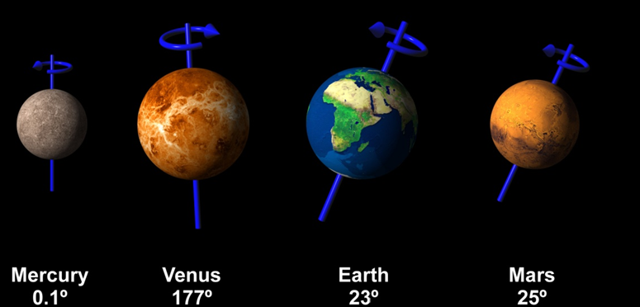
See how they spin. . .

Slide 29
Astronomical Hierarchy The universe is made up of many different structures arranged in a fairly well-defined hierarchy.
Definition of Hierarchy:
an arrangement or classification of things according to relative importance

Slide 30
Astronomical Hierarchy

Slide 31
Big Bang Balloon Lab
You are working in pairs (2)
The partner next to you or I will assign you a partner
You need:
1 balloon
1 permanent marker
1 piece of string
No ruler necessary:
using the written ruler on your paper instead

Slide 32
Big Bang Balloon Lab
Expectations:
You are following the procedure exactly as it says
This is why we studied the importance of procedures*
Do not get up out of your seat unless authorized
Talk quietly with only your partner
You have the rest of class to finish the lab
Including data collection & comprehension questions
If you finish early, clean up & work on HW
Reminder: we have an exit ticket so must end 5 minutes before bell
I will give you this warning signal

Slide 33
Exit Ticket
Word Bank:
Planets
Universe
Galaxies
Solar Systems
Using the word bank, answer:
Which was created first?
Which was created last?
Which was formed from colliding asteroids?
The milky way is one of these.

