Slide 1
MONDAY!
Warm Up
Who said that planets orbit in elliptical shapes, not perfect circles?
Which do you think heats up quicker, water or land?
What is the sun good for (what do we use it for here on earth)?

Slide 2
2.4- Last Day of New Content!
Objective
Agenda
SWBAT explain Kepler’s three laws
SWBAT describe the sun’s energy and importance on Earth
HW/Reminders: UNIT 2 TEST IS THURSDAY. START STUDYING!
Warm Up
Objective
Guided Notes
Tic-Tac-Toe
2.4 Quiz
If extra time- space journey video and/or nebula photos

Slide 3
Class Update
3 Bathroom Passes per semester
You must keep track of them in order to go
You may not use another students passes
Progress Reports will be handed out today at end of class
If you didn’t give me Unit 1 Work last week- you have until Thursday to give it to me for 50% credit
When I ask for complete sentences- I expect complete sentences
Balloon lab was out of 30 points but not many received this amount because it lacked complete sentences
If you missed Unit 1 Test from last Tuesday- Must take it after school this week!
Some students didn’t know there was a back so you must come after school to finish

Slide 4
Class Update
Unit 2: Astronomy Test on Thursday
Today is the last day of new material
Tomorrow is review via Astronomy Booklet independent project
Project grade
Wednesday is 2nd day of review via review questions & crossword
Review assignment
We will be taking a quiz everyday at the end of class up to the test to check your mastery before the assessment

Slide 5
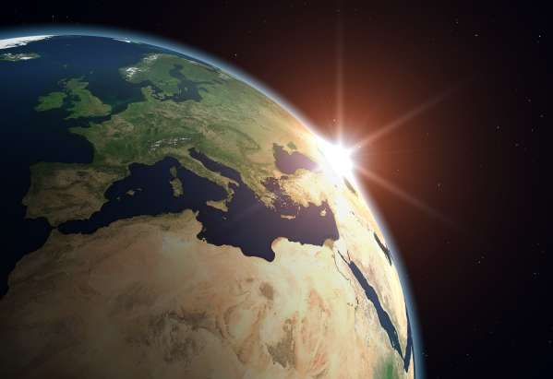
Kepler’s 3 Laws

Slide 6
The Birth of Modern Astronomy
Johannes Kepler (1571-1630) – Studied under Brahe and continued his work by using math to develop 3 laws of planetary motion.

Slide 7
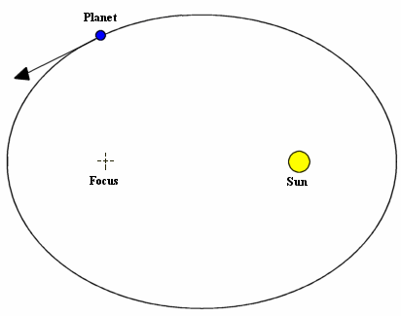
Kepler’s 1st Law Of Planetary Motion
Each planet moves in an ellipse rather than a circle

Slide 8
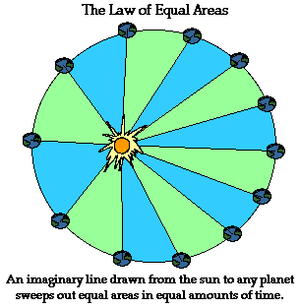
Kepler’s 2nd Law Of Planetary Motion
Kepler’s second law says that an imaginary line between the sun and a planet sweeps out equal amounts of area in equal amount of time

Slide 9
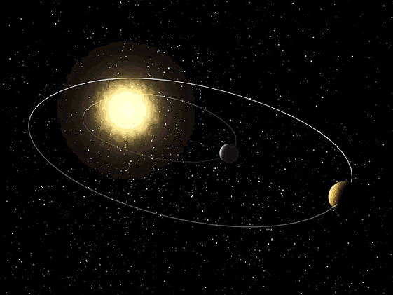
Kepler’s 3rd Law Of Planetary Motion
States that the planet’s orbital period squared is equal to its mean solar distance cubed:
T² = d³, where T = planet’s orbital period and d = solar distance
Therefore, the solar distances of the planets can be calculated when their periods of revolution are known.

Slide 10
Energy from the Sun (Fusion)
Energy from the sun is called solar energy. Solar energy is the solar radiation that reaches the earth.
This Energy is created by Nuclear Fusion that takes place at the sun’s core.
Each second the sun converts about 600,000,000 tons of Hydrogen nuclei into Helium nuclei.
When the H converts to He, some neutrons are lost and released as ENERGY that gives off HEAT and LIGHT into our solar system.

Slide 11
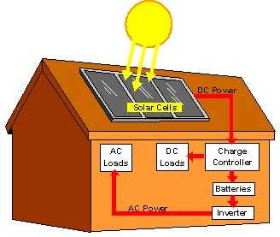
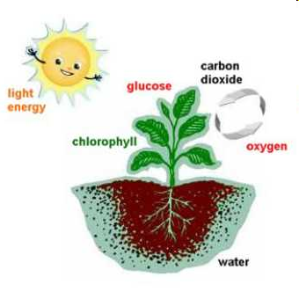
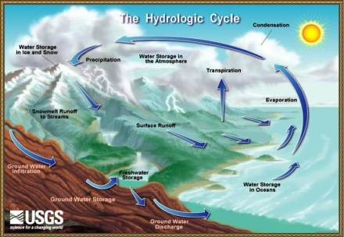
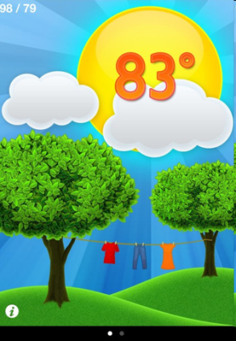
Roles the Sun Plays here on Earth:
It is a major source of energy.
It helps plants to grow.
It is part of the water cycle.
It dictates the seasons.
It controls the weather.

Slide 12
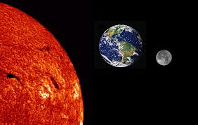
Differential Heating
Land and water surfaces absorb heat at different rates
Water has a higher capacity for storing heat than land
This means the ground will heat up much quicker than water from the same amount of sun radiation
Water- heats and cools slowly
Land- heats and cools quickly

Slide 13
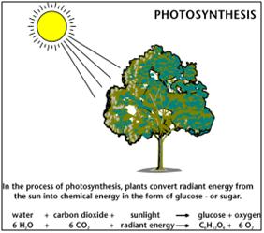
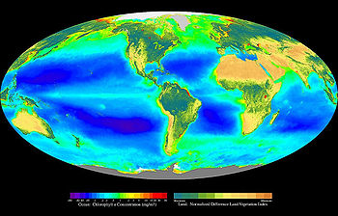
Photosynthesis
Solar energy is transferred to chemical energy through photosynthesis
Occurs in plants, algae, and some bacteria
Convert carbon dioxide and water using energy from the sun to sugar (chemical energy)

Slide 14
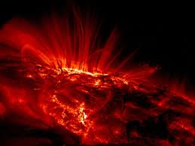
The Sun’s Energy
Electromagnetic Radiation: heat energy from the sun
Radiation is emitted throughout the electromagnetic spectrum at the speed of light, whether or not we can see it. The shorter the wavelength, the higher the energy.
Solar radiation is composed of:
40% at wavelengths of infrared (IR) or longer
50% at visible wavelengths
10% at wavelengths of ultraviolet (UV) or shorter (think: skin penetration)

Slide 15
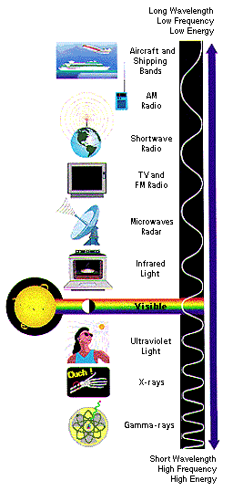

Slide 16
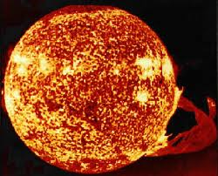
The Sun’s Energy
The Sun also emits other types of radiation such as X-rays and cosmic rays
These rays are absorbed by Earth’s atmosphere before they reach Earth

Slide 17
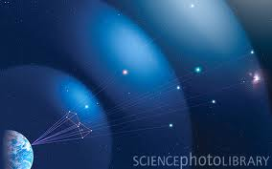
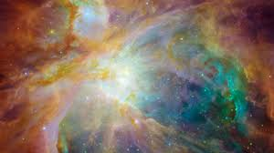
RANDOM FACT!
Orion nebula is 1,344 light years away

Slide 18
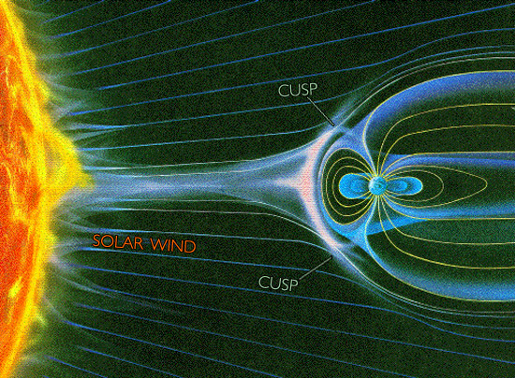
Solar Winds
The sun also creates solar winds.
They are a continuous stream of electrically charged particles that are given off by a magnetic field around the sun.
It takes a solar wind about 4.5 days to reach Earth.

Slide 19
So why don’t we burn up?
The earth has a magnetic field that protects us by deflecting the solar winds.
You can even see the interaction between our magnetic field and the solar winds when auroras are created. The most famous are in the northern hemisphere and called the aurora borealis. Auroras also appear on other planets with magnetic fields.

Slide 20
TIC-TAC-TOE!
Read the directions on the back of your notes page
You should be writing/drawing your responses on a separate sheet of paper. I have markers/colored pencils.
You may talk QUIETLY with a neighbor as your work
Ask permission before getting out of your seat
Reminder: NO headphones
I will play music if we are working hard and staying on task

Slide 21
Reward Video Time
www.youtube.com/watch?v=ys47ZXPTRio
Travel in the Universe

Slide 22
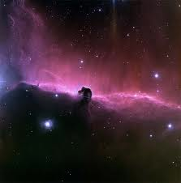
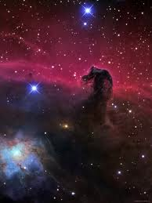
Nebulas!

Slide 23
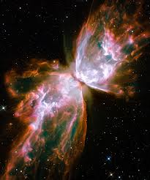
Butterfly

Slide 24
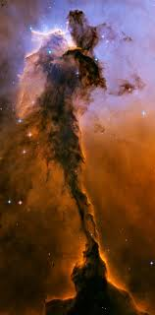
Eagle

Slide 25
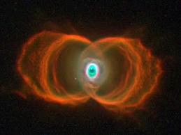
Hourglass

Slide 26
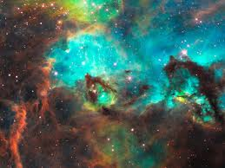
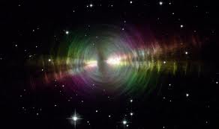
Egg Tarantula

Slide 27
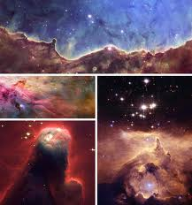

Slide 28
2.4 Exit Quiz
During this time I will pass out progress reports
No questions about grades
Must come after school to discuss
Tutoring this week: Tuesday, Wednesday & Thursday

