Slide 1
Objective
SWABT define the term: weathering.
SWBAT differentiate between chemical or mechanical weathering.

Slide 2
Initial Definitions
Independently Completing
What is chemical weathering?
What is physical weathering?
How does chemical weathering differ from physical weathering?
What are some factors that affect the rate (speed) of chemical weathering?

Slide 3
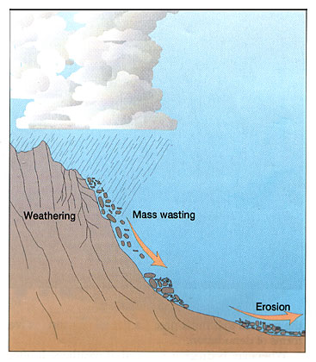
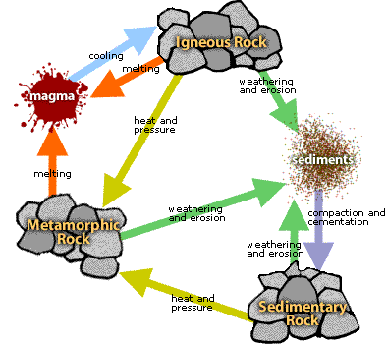
What Is Weathering?
The breakdown of rock into smaller and smaller pieces
This is where we are focusing today!

Slide 4
There are two main types of weathering
Chemical weathering:
the chemical breakdown of rocks and minerals into new substances (ex: water, acid rain)
Mechanical Weathering:
the breakdown of rock into smaller pieces by physical means (ex: ice, water, gravity, plants)

Slide 5
How Does Surface Area affect the Rate of Weathering?
3. How does chemical weathering differ from physical weathering?
The way or method the rock undergoes to turn into small sediments (rock pieces)

Slide 6
How Does Surface Area affect the Rate of Weathering?
4. What are some factors that affect the rate (speed) of chemical weathering?
Climate, humidity (moisture in the air) & temperature

Slide 7
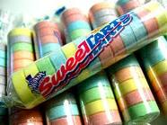
Comparing mechanical and chemical weathering
Demo: Sweet tarts and acid
Create a hypothesis: Which sweet tart do you think will dissolve the quickest?

Slide 8
How Does Surface Area affect the Rate of Weathering?
MATERIALS:
5 Sweet Harts
5 Sweet Harts broken down “weathered”
2 cups
White Vinegar
Timer
EXPERIMENTAL SET UP:
Draw the set up in the box

Slide 9
Speed (rate of weathering)
Choose one for each blank Faster or Slower
IF sweet tarts are placed in vinegar, THEN they will be weathered __________________ than mechanically weathered sweet tarts.
IF a student smashes sweet tarts, THEN they will be weathered __________________ than chemically weathered sweet tarts.

Slide 10
Size of Sediments
Choose one for each blank Bigger or Smaller
IF sweet tarts are placed in vinegar, THEN the sediments will be __________________ than mechanically weathered sweet tarts.
IF a student smashes sweet tarts, THEN the sediments will be __________________ than chemically weathered sweet tarts.

Slide 11
Combination of both weathering
Choose one for the blank Faster or Slower
IF a student smashes sweet tarts and then places sediments into vinegar, THEN I predict the rate of weathering will be __________________ rather than applying just one type of weathering.

Slide 12
Turn & Talk
Follow Up Question: Based on the results of your experiment, predict which of these would weather the fastest - a smooth round pebble or a jagged piece of rock. Why?

Slide 13
How Does Surface Area affect the Rate of Weathering?
Follow Up Question: Based on the results of your experiment, predict which of these would weather the fastest - a smooth round pebble or a jagged piece of rock. Why?
Objects with more surface area weathers faster!!

Slide 14
VIDEO TIME
http://app.discoveryeducation.com/search?Ntt=weathering

Slide 15
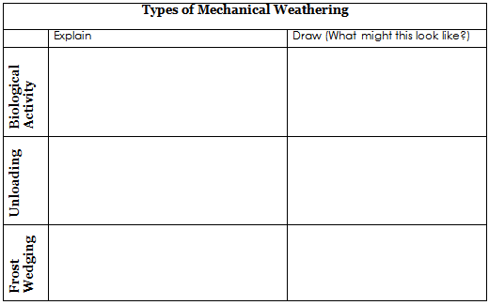
Let’s take a deeper look…

Slide 16
Biological Activity

Slide 17
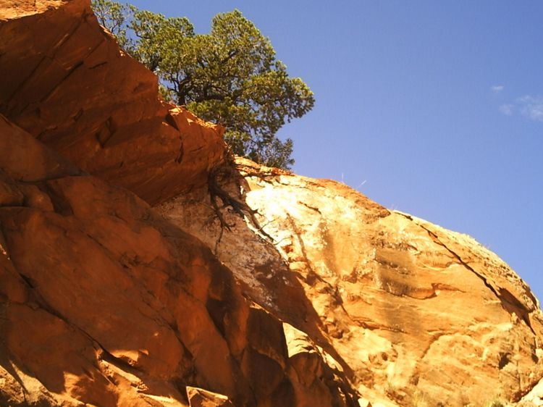
Biological Activity
Activity of organisms
  Growing roots, burrowing animals, deforestation
  Life via plants or animals accelerate weathering = breaking down of rocks into sediments

Slide 18
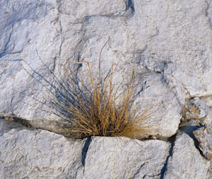
Mechanical Weathering: PLANTS
Plants often send their roots into existing cracks in rocks.
As the plant gets bigger, the force of the expanding root becomes so strong that the crack is made larger.

Slide 19
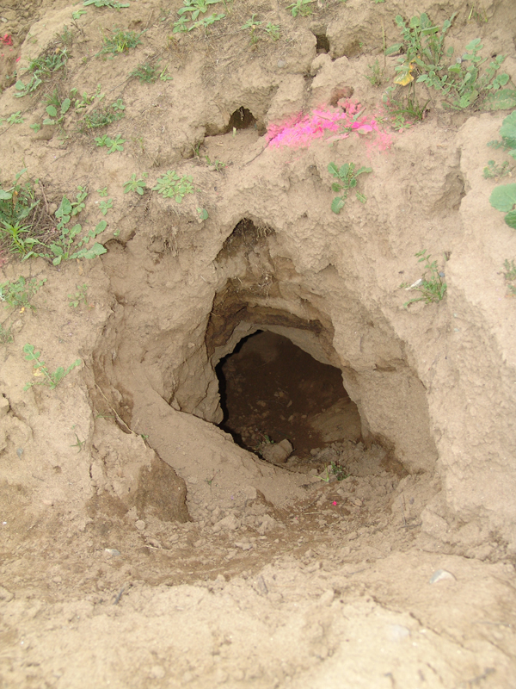
Mechanical Weathering: ANIMALS
Almost any animal that burrows causes mechanical weathering
These may include animals like ants, mice, coyotes, and rabbits

Slide 20
Mechanical Weathering: WIND, WATER and GRAVITY
All types Wind, Water, Gravity use...
Abrasion: the action of rocks and sediments grinding against each other and wearing away exposed surfaces

Slide 21
Mechanical Weathering: WIND, WATER and GRAVITY
When wind blows against exposed rock, the sand eventually wears away the rock’s surface

Slide 22
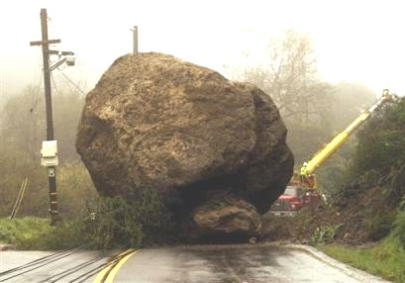
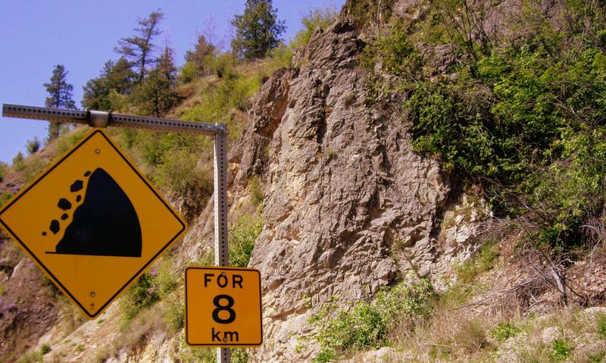
Mechanical Weathering: WIND, WATER and GRAVITY
As rocks are pulled down by gravity, they can start falling down mountains.

Slide 23
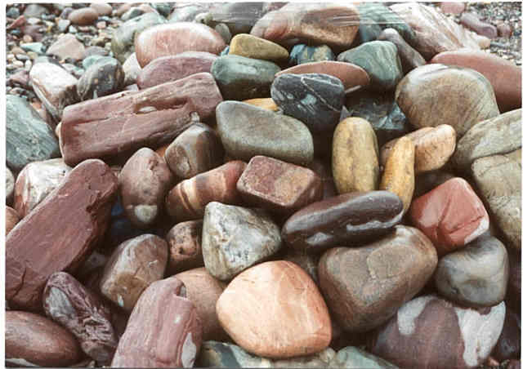
Mechanical Weathering: WIND, WATER and GRAVITY
When rocks and pebbles roll along the bottom of swiftly flowing rivers, they bump into and scrape against each other.

Slide 24
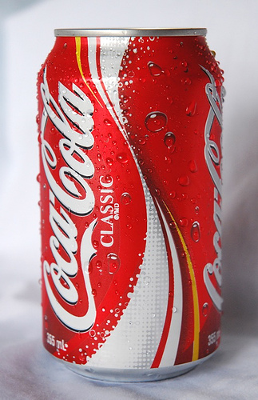
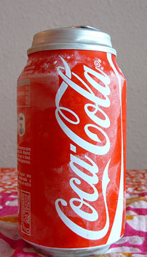
What happens when you freeze a coke can?
The liquid expands, and often times the can will bust!

Slide 25
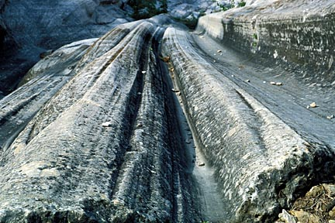
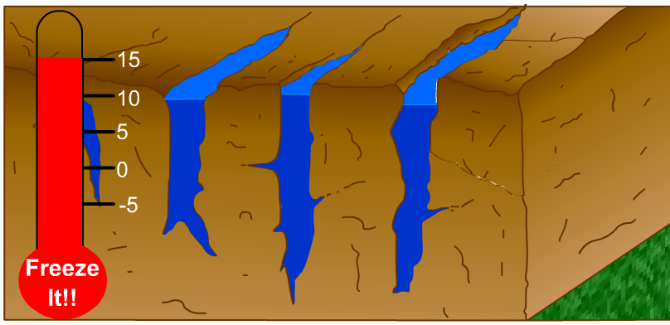
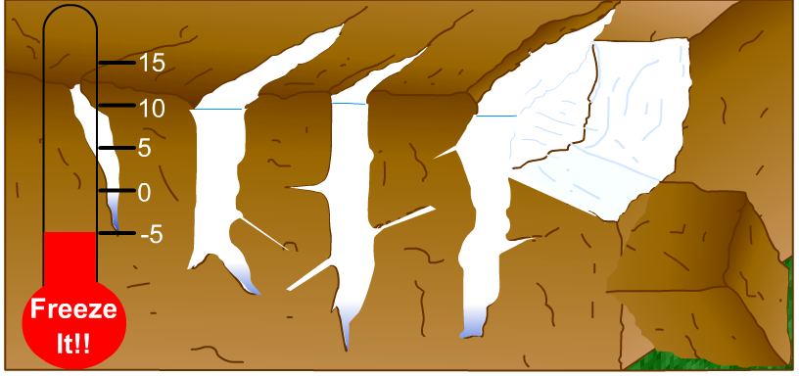
Frost Wedging
Warm weather = seeps into cracks
When water freezes and expands, it enlarges cracks in rocks.

Slide 26
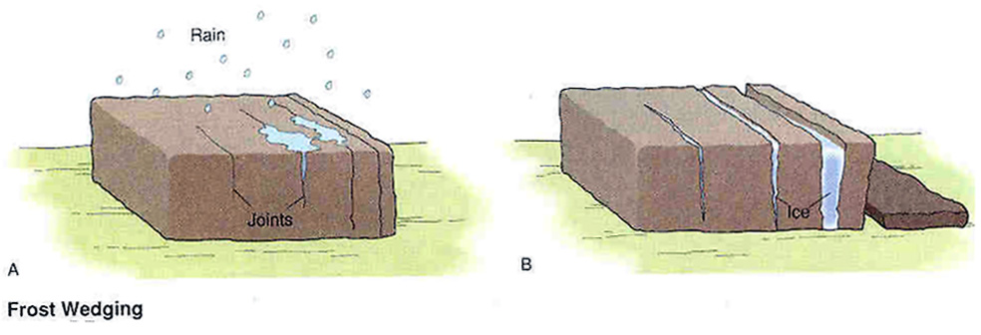
Mechanical Weathering: ICE Wedging

Slide 27
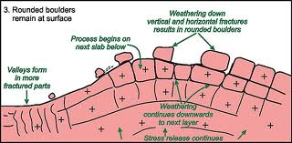
What is unloading
It is the process which layers of rocks under the surface are exposed
You need to know “unloading” is mechanical!

Slide 28
Checks for understanding
Hands on CHIN
  Which of the following is NOT a cause of mechanical weathering?
Dissolving
Frost wedging
Abrasion
Burrowing

Slide 29
There are two main types of weathering
Chemical weathering:
the chemical breakdown of rocks and minerals into new substances (ex: water, acid rain)
Mechanical Weathering:
the breakdown of rock into smaller pieces by physical means (ex: ice, water, gravity, plants)

Slide 30
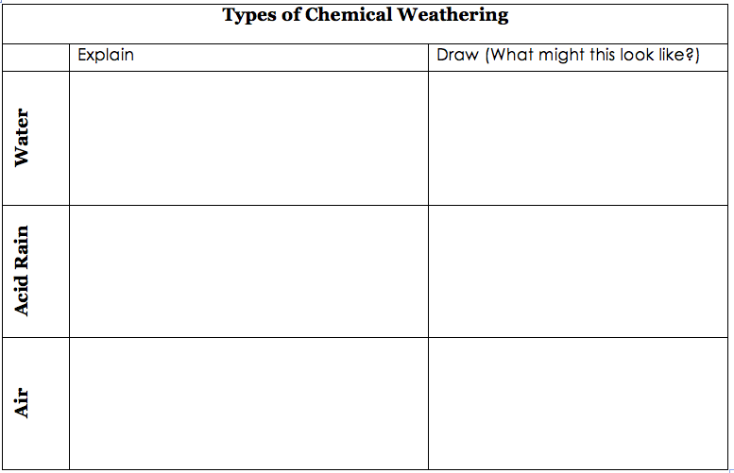
Let’s take a deeper look…

Slide 31
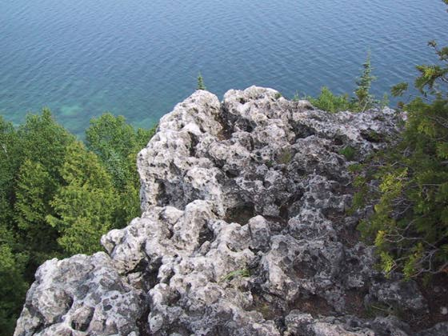
Chemical Weathering: WATER
Rocks can be dissolved by water
Even hard rock, is broken down by water
It may take a few thousand years

Slide 32
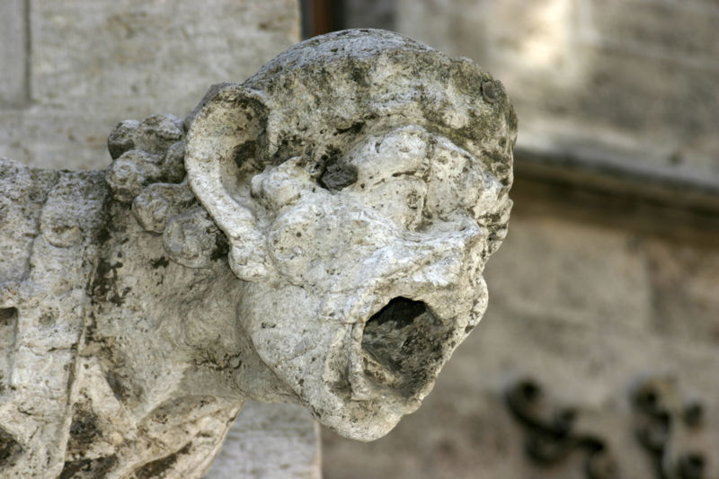
Chemical Weathering: ACID RAIN
Caused by air pollutants (co2) enter water cycle
Slowly break down rocks and other matter

Slide 33
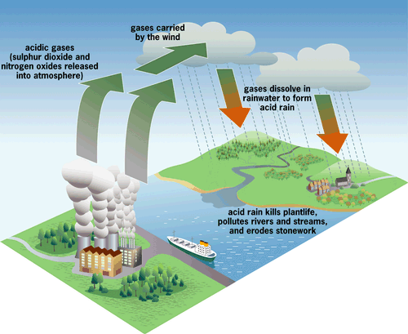
Chemical Weathering: ACID RAIN
When fossil fuels are burned, they give off gases, and combines with water in the atmosphere, they can fall back to the ground in rain or snow

Slide 34
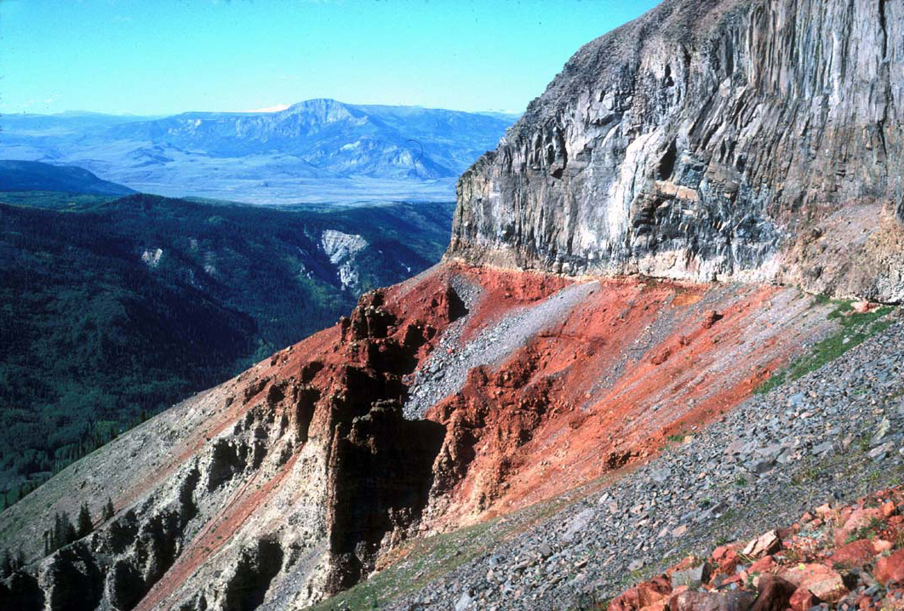
Chemical Weathering: AIR
In rocks that contain iron, oxidation (rust) may occur
Oxidation is a chemical reaction in which an element combines with oxygen to form an oxide (basically, the easy way to say this is that stuff rusts!)

Slide 35
Climate
Chemical Weathering happens in WARM & WET

Slide 36
Checks for understanding
Hands on CHIN
  Which of the type of chemical weathering is responsible for turning the statue of liberty green?
Dissolving
Acid Rain
Abrasion
Oxygen

Slide 37
Checks for understanding
Hands on CHIN
  Which is responsible for creation of rust?
Dissolving
Acid Rain
Abrasion
Oxidation

Slide 38
Checks for understanding
Hands on CHIN
  In which climate does chemical weathering occur most rapidly?
Cold, dry
Cold, wet
Warm, dry
Warm, wet

Slide 39
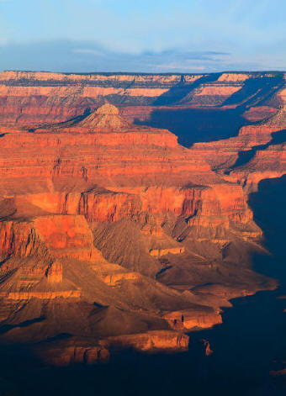
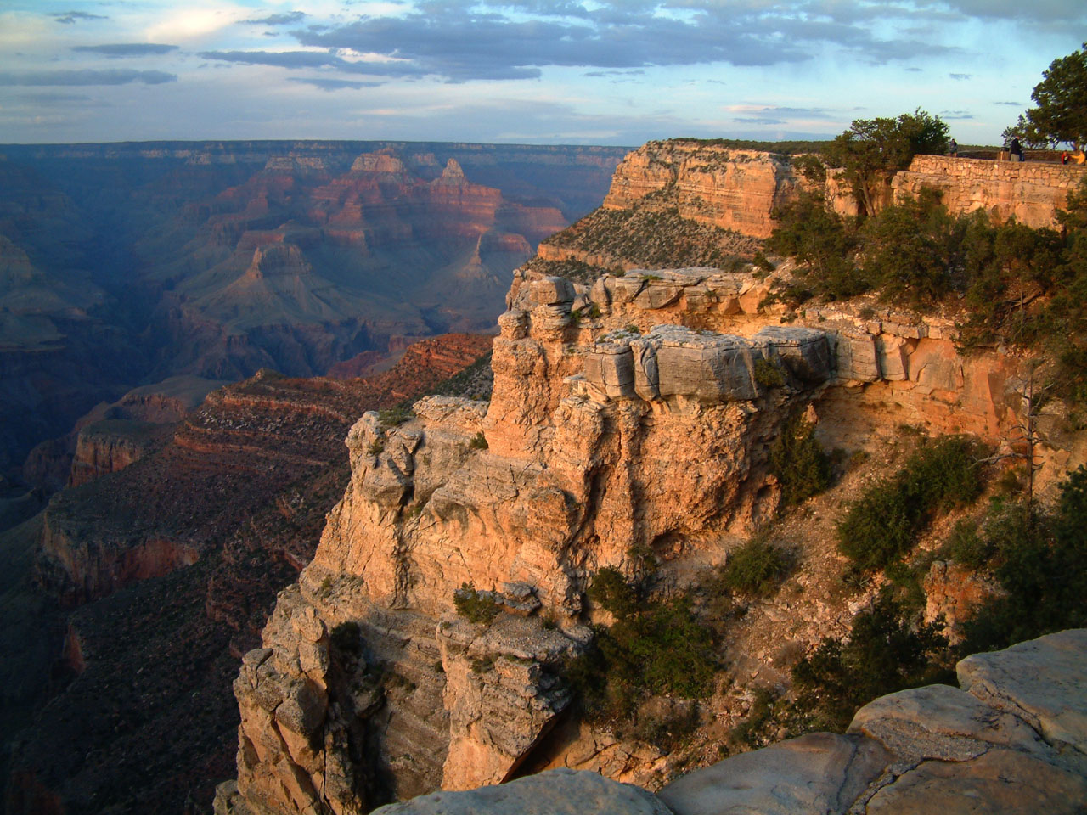
The Grand Canyon in Arizona

Slide 40
Anticipation & Connections
Deposition: when weathered rock and soil particles build up in one place
Weathering, erosion and deposition never stop. They are part of a continuous cycle.

Slide 41
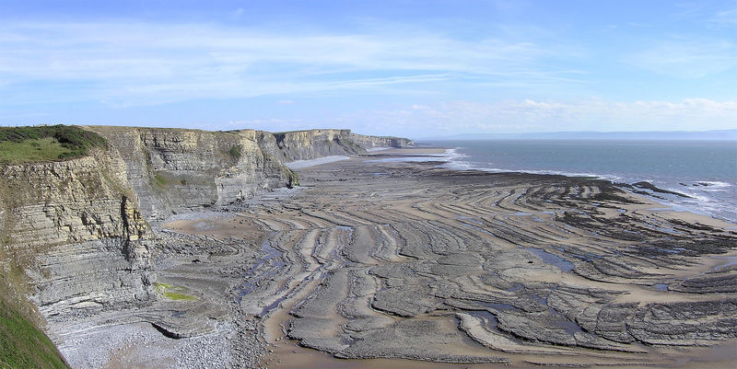
Tomorrow: We Continue with
Five Forces of Erosion
There are five main factors of erosion:
Gravity
Wind
Running Water
Glaciers
Waves

Slide 42
Independent Practice
Complete Tic-Tac-Toe board practice
  Use all notes from Unit 3
Complete Crossword when finished

