Slide 1
Warm Up!
What are the 2 types of weathering?
How does weathering change the earth?
Give 3 examples of the 6 we learned yesterday.
Is weathering good or bad? Explain your answer!

Slide 2
Objective
SWBAT give & explain examples of the four (4) agents of erosion
SWBAT examine the Grand Canyon as a case study by outlining the types of erosion that created this formation.

Slide 3
3.3 Quiz – on our way to mastery
Question # 8

Slide 4
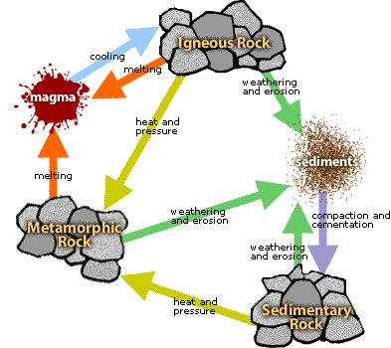
3.3 Quiz – on our way to mastery
Question # 10
This is what we’re talking about:
Igneous changes into sedimentary via
1. Weathering
2. Erosion
3. deposition

Slide 5
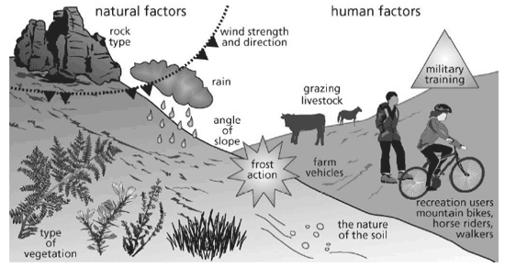
Erosion: A Destructive Natural Force
Unit 3, Lesson 4

Slide 6
Erosion
The transportation of material by wind, water, ice, or gravity on the Earth’s surface.

Slide 7
How does erosion differ from weathering?
Weathering BREAKS DOWN the Earth’s material into sediments.
Where as, erosion TRANSPORTS the sediments to a new location.

Slide 8
After the material is transported where does it go?
The sediments BUILT UP in on place is called deposition.
Both erosion and deposition change the shape of the Earth’s surface. Erosion transports materials from place to place. Deposition builds new landforms.
Weathering, erosion, and deposition form a cycle of forces that wear down an build up the Earth’s surface!

Slide 9
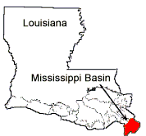
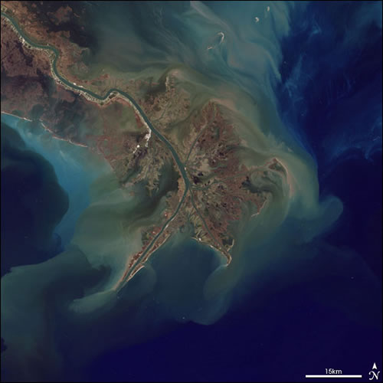
Louisiana!
The entire river basin in Louisiana is the product of sediment deposition from the Mississippi River following the latest rise in sea level about 5,000 years ago.

Slide 10
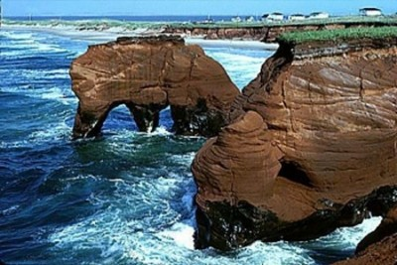
Erosion can occur because of…
Wind
Water
Ice
Gravity
We will return to this...

Slide 11
EROSION Readings
Each pair (2 students) has a reading.
Together you will read & answer questions about:
Wind & Water Erosion
You have 7 minutes for each reading…write fast!

Slide 12
Erosion Videos
Answer questions as we go
Grand Canyon: Videohttp://www.youtube.com/watch?v=ktf73HNZZGY
Gravity: Video (Discovery Ed: Erosion by Gravity and ice: http://app.discoveryeducation.com/search?Ntt=Erosion+by+Gravity+and+ice ---watch til 2:40 for gravity/landslides)
Glaciers: Video (same DE link as above, 2:40-4:30)

Slide 13
Erosion can occur because of…
Wind
Water
Ice
Gravity
And we’re back...

Slide 14
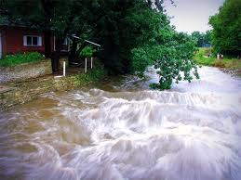
Water Flooding

Slide 15
Water
Running water is the BIGGEST cause of erosion all over the world.
When rain falls on the Earth’s surface, three things can happen:
the rain can evaporate,
it can sink into the ground,
or it can flow over the land surface as runoff.
When water moves across the land as runoff, it picks up and carries particles of clay, sand and gravel.
When you include gravity, the water and sediments move downhill.

Slide 16
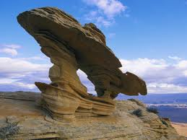
Wind

Slide 17
Wind
Wind is the most active agent of erosion in deserts, in plowed fields, and on beaches. This loose material can easily be picked up and carried by the wind.
As the wind blows, the larger particles roll or bounce along the ground. These particles slowly wear away exposed rocks. These particles often act like a sandblaster, cutting, and polishing rocks. This type of wind erosion is called abrasion.

Slide 18
Arbol de Piedra in Altiplano, Bolivia

Slide 19
Ice
The Matterhorn, the border of Switzerland and Italy

Slide 20
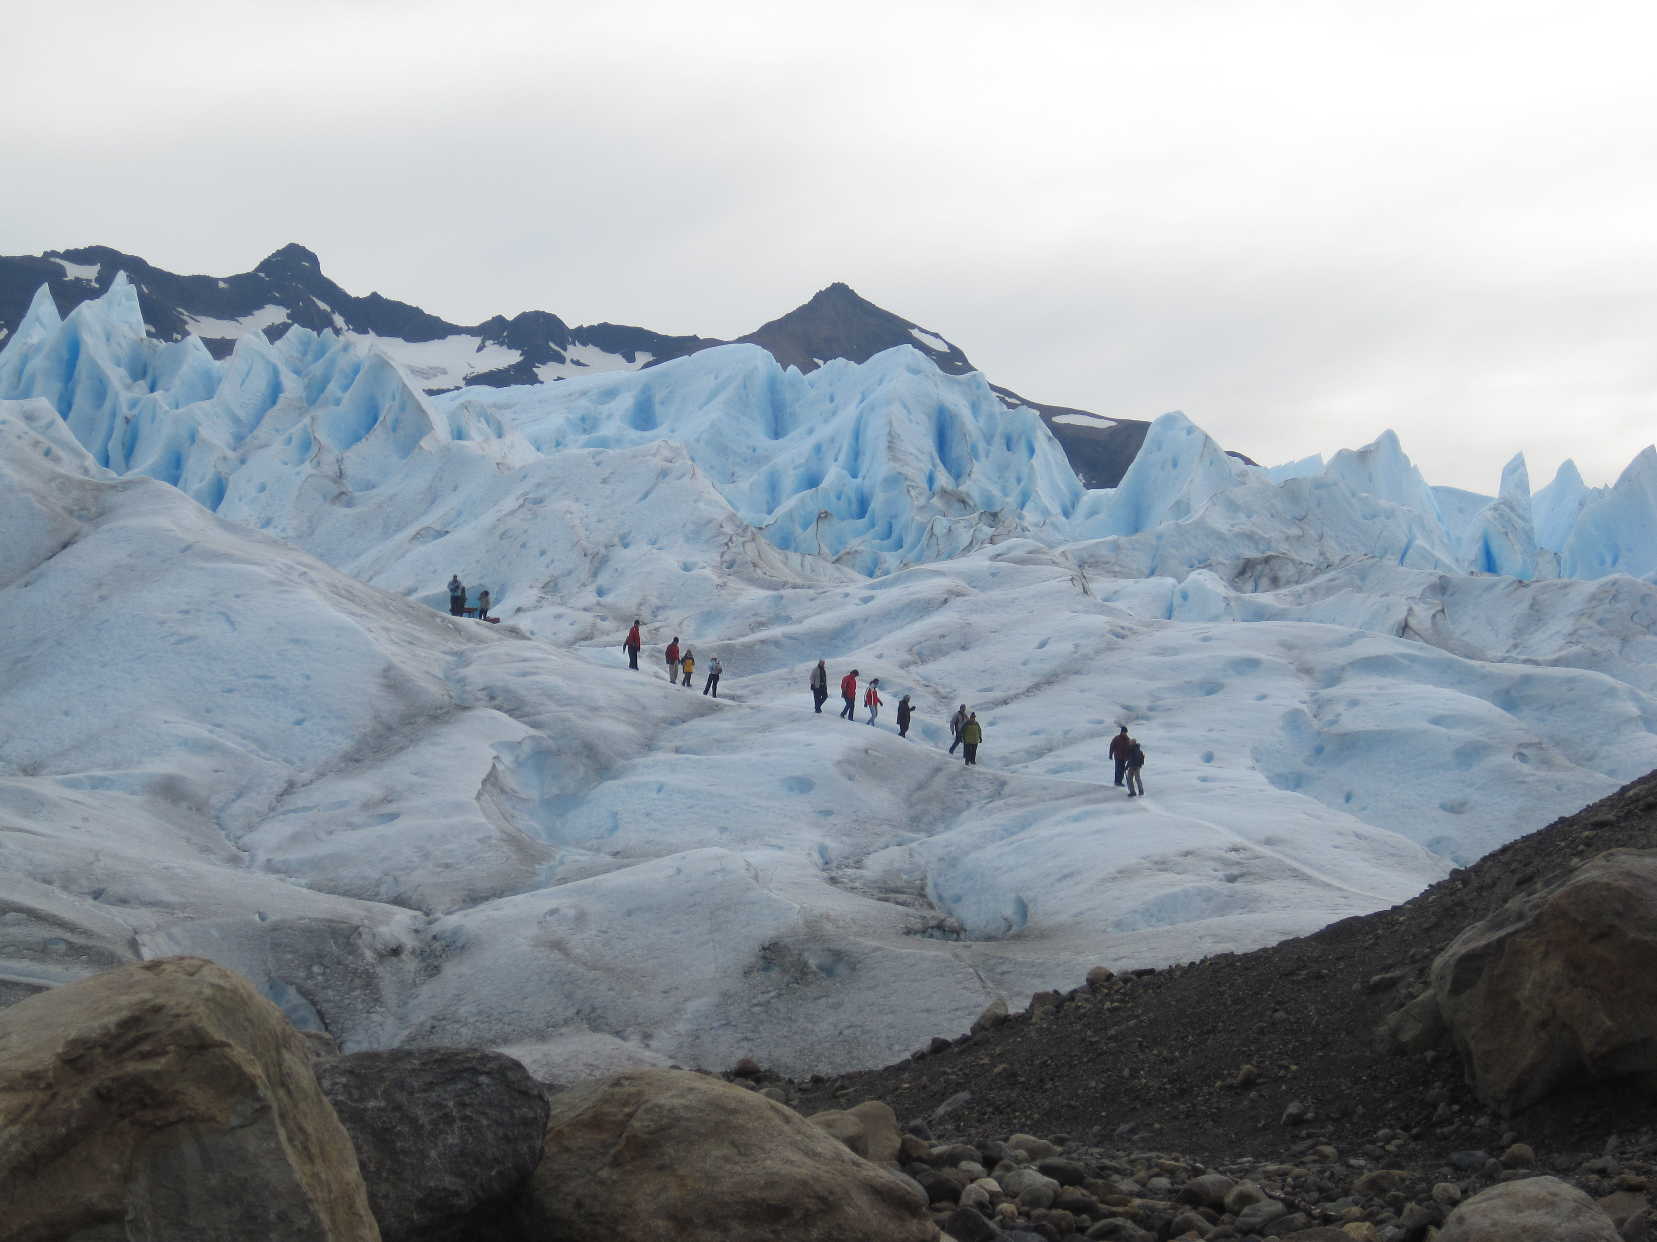
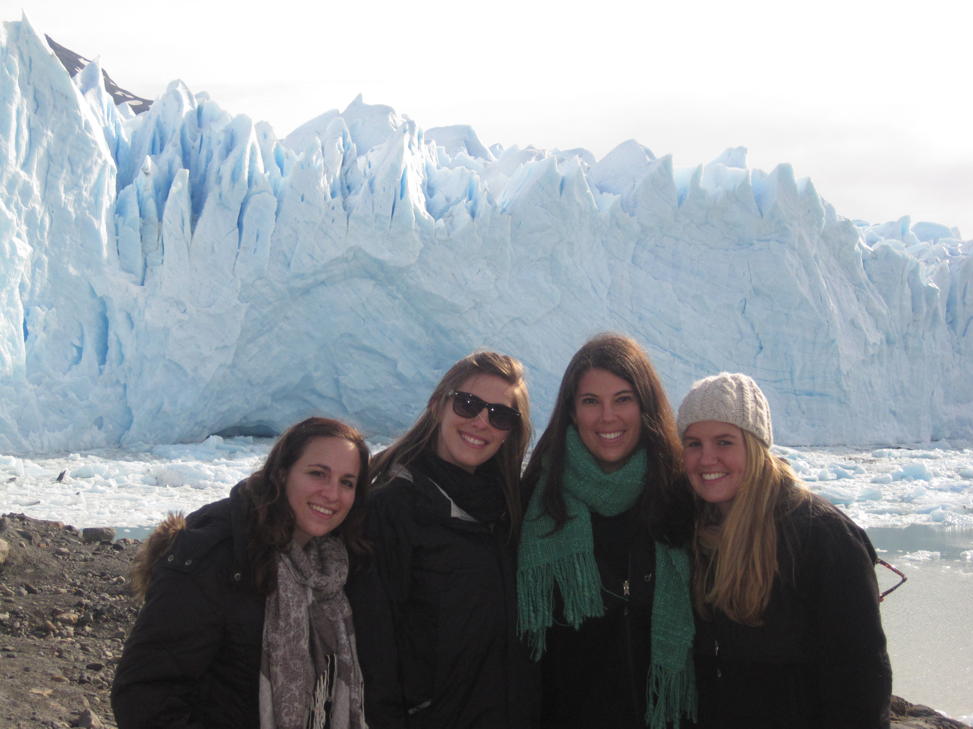
Perito Moreno in Argentina!

Slide 21
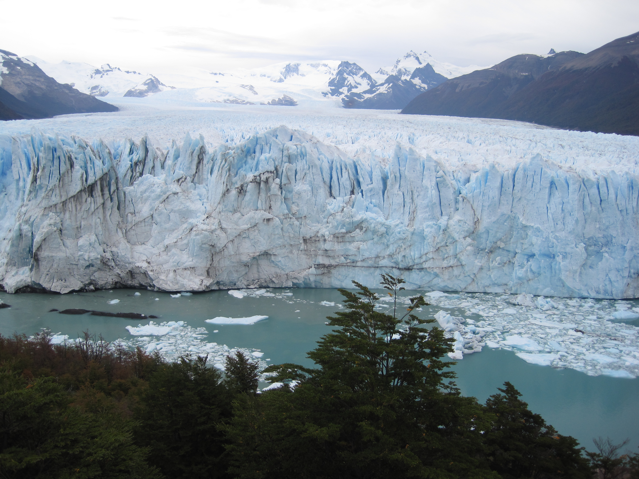
Ice
Huge masses of moving ice are called Glaciers.
Glaciers erode by mainly two different processes: Abrasion and Plucking.
Abrasion: glacial ice and rock fragments smooth and polish the bedrock surface like sandpaper.
Plucking: rock breaks up beneath the glacier and the melted water the goes into the cracks. This water refreezes and pries the rock apart. The ice pulls parts of rock away from the original bedrock.

Slide 22
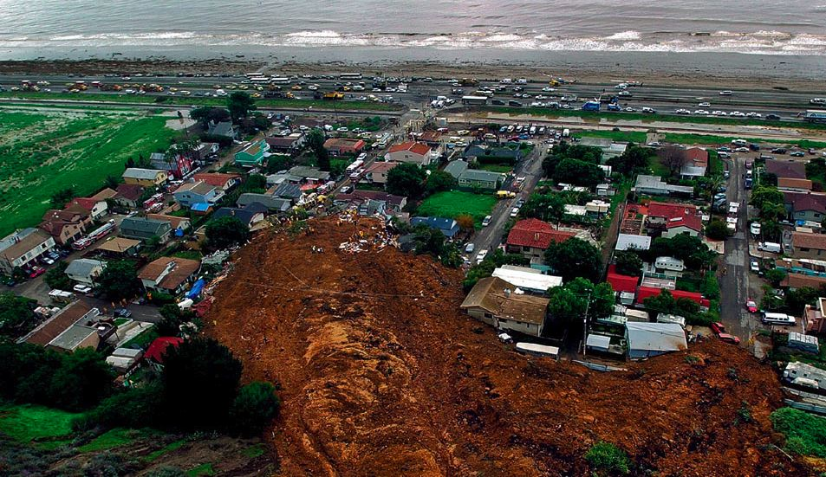
Gravity
Mudslide

Slide 23
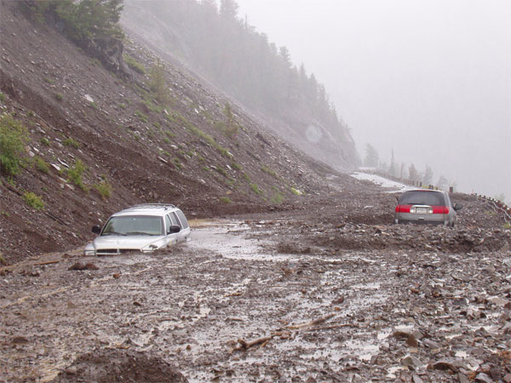
Gravity
Mass Wasting: down slope of rocks and sediments because of gravity.
Gravity is a big player involved in the other 3 types of erosion
Water, Ice & Wind are affected by Gravity

Slide 24
Quick Check!
On Earth, which is the predominate agent of erosion
Gravity
Wind
Moving Ice
Running Water

Slide 25
Quick Check!
For which movement of earth materials is gravity not the main force?
sediments flowing in a river
boulders carried by a glacier
snow tumbling in an avalanche
moisture evaporating from an ocean

Slide 26
Quick Check!
Which agent of erosion is apparent in all 4 of the diagrams?
Wind
Running Water
Ice
Gravity

Slide 27
Let’s Review
Chemical or Mechanical weathering?!
Put up a C for Chemical
Put up an M for Mechanical
Can you name it?

