Slide 1
Warm Up
Predict: What are the top ingredients in soil?
Why is it important to talk about soil?
What type of soil do we have in North Carolina?

Slide 2
Objective Agenda
SWBAT identify soil composition by reading a soil pyramid
Do Now
Objective
Soil Guided Notes
Soil Practice in Partners
Build your own town
Exit Ticket
Homework
Build your own town
Due Thurs 11/6

Slide 3
Announcements!
Tutoring: Thursday 230-3pm
I can help with organization, make up work, retests
Unit 2 Test Grades coming this week

Slide 4
Warm Up
Predict: What are the top ingredients in soil?
Why is it important to talk about soil?
What type of soil do we have in North Carolina?

Slide 5
85% Mastery is Our GOAL
We are on our way
Lets focus only on soil today

Slide 6
Why should we study soil?
SWBAT able to identify soil composition by reading a soil pyramid

Slide 7
Expectations for Guided Notes
Clear your desk
Pen/Pencil in hand
Stay seated, sit up & face forward
No talking
Raise hand for questions
No bathroom passes at this time

Slide 8
As rocks are broken down by the process called weathering , small pieces of rock (sediments) are formed.
These small pieces of rock are then eroded, or carried away.
These pieces of sediment will eventually form sedimentary rock. However, before other sediments are placed on top of them, these small pieces of rock form soil.

Slide 9
What is soil?
the upper layer of earth in which plants grow, a black or dark brown material typically consisting of a mixture of organic remains, clay, and rock particle

Slide 10
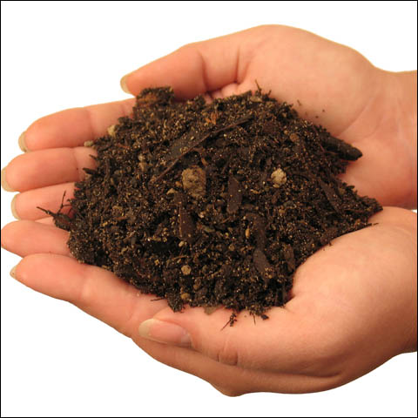
Soil is also made up of humus (dead plants and animals), minerals, air and water.

Slide 11
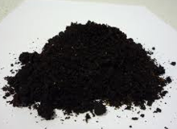
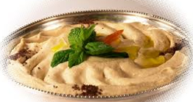
Hum a what??
Humus – plants = decayed remains of animal and plant life
OR
Humus – food = smashed up chick peas

Slide 12
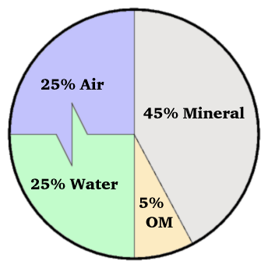
SOIL!
Draw this pie chart in the top left of your guided notes:
Shows good quality soil:
OM = organic material

Slide 13
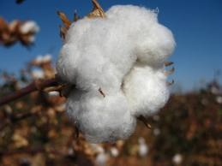
What kind of soil does NC have?
Red clay – improved by adding organic matter
Leading field crop? Tobacco and cotton

Slide 14
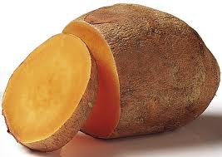
What is the largest food crop in NC?
Peanuts and sweet potatoes
Apples
Hay and wheat

Slide 15
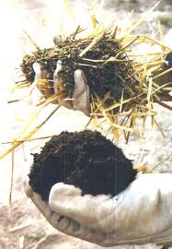
What is organic matter?
-well-rotted leaves
-compost
-horse manure (gross…. But true!)
-peat moss (a specific types of soil…)

Slide 16
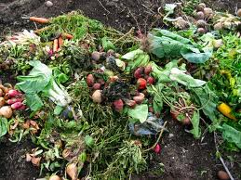
What is compost?
The recycling of organic waster material
What are some examples??
Leaves, grass clippings, straw, weeds, plant parts
(RECYCLING is more than just paper)
What is compost used for?
Rich humus to help our plants grow!

Slide 17
Flip your paper over!!!

Slide 18
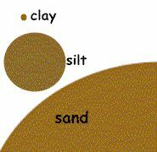
Draw the size order!
US Department of Agriculture has established categories based on the percentages of clay silt and sand in the soil.

Slide 19
SWBAT able to identify soil composition by reading a soil pyramid
We use a soil pyramid by finding the intersection point between the three types of particles.
You already have experience with this skill...

Slide 20
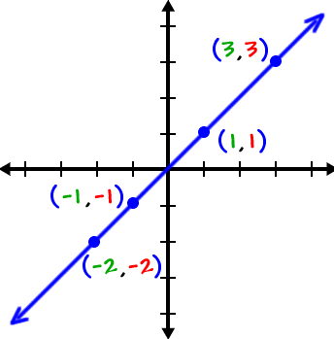
Intersection points while...
Graphing
X & Y axis = one coordinate point

Slide 21
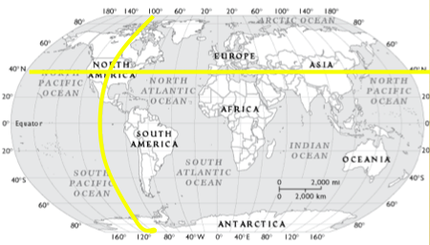
Intersection points while...
Latitude & Longitude
Coordinate points
Latitude = N or S
Longitude = E or W

Slide 22
SWBAT able to identify soil composition by reading a soil pyramid
Developing new skills can be frustrating
Learning means staying focused & persistent
We use a soil pyramid by finding the intersection point between the three types of particles.

Slide 23
Circle Silt
Circle Clay
Circle Sand

Slide 24
Draw the Arrows
DOWN
ACROSS
UP

Slide 25
Characteristics
Find the point where all 3 lines meet.
This intersection point determines the type of soil

Slide 26
Example: 50% clay, 30% silt and 20% sand is...
DOWN
ACROSS
UP

Slide 27
Example: 10% clay, 40% silt and 50% sand is...
DOWN
ACROSS
UP

Slide 28
Your turn to practice
In your seat, try 3-8.
Ask your partner for help first
I will be circulating
Stay seated
Talk quietly
Expect to be randomly called upon *popsicle sticks* to show me your skills

Slide 29
DOWN
ACROSS
Example: 10% clay, 40% silt and 50% sand is...
UP

Slide 30
Expectations for Guided Notes
Clear your desk
Pen/Pencil in hand
Stay seated, sit up & face forward
No talking
Raise hand for questions
No bathroom passes at this time

Slide 31
Fill in the blank
Soil type is determined by the 1 ________of particles.
2 ___ is the smallest sized particle
Silt is the 3 _____ sized particle
4 ___ is the largest sized particle
5 _____ is the rich organic material that consists of 5% of good quality soil.
Soil sits on the top of the 6_______.

Slide 32
Planning Your Own Town
SWBAT apply soil knowledge in Build Your Own Town project
Lets talk about it together then talk with partner

Slide 33
Planning Your Own Town
Complete Brainstorm Questions
Then flip sheet & begin reading the back side
Which job will be the easiest? Why?
Which job will be the hardest? Why?

Slide 34
Planning Your Own Town
Complete Brainstorm Questions
Then begin looking at your map
Which soil is the best for farming?
Which soil is the best for building on?

Slide 35
Planning Your Own Town
Work on this for the rest of class
Expectations:
Stay seated, face forward
Raise hand for questions
Talking quietly

Slide 36
EXIT TICKET!
Slip of paper – turn it in!
Review Tuesday!
Test on Wednesday!

Slide 38
What is humus? (EES Related)
Chick peas
Soil
Weathered rock
Decaying organic material

Slide 39
What is the smallest particle made that determines the type of soil?
Sand
Clay
Silt
Loam

Slide 40
What is the main soil in North Carolina?
Sand
Silty Clay Loam
Red Clay
Silty loam

Slide 41
Which of these factors affects the rate of chemical weathering?
Climate
Chemical composition of the exposed rock
Surface area of the exposed rock
All of the above

