Slide 1
Guided Notes
Applying unit 3 to the earth as a whole
How does erosion affect the
Earth’s landscape & lithosphere?
Stay seated, heads up, eyes up
Silently Listening
No bathroom passes

Slide 2
How are tides a form of erosion?
Waves receive their energy from winds that blow across the water surface.
Size of a wave depends on
how fast
how far
how long the wind blows

Slide 3
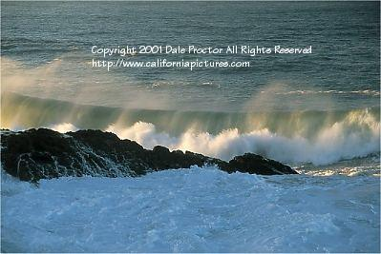

Slide 4
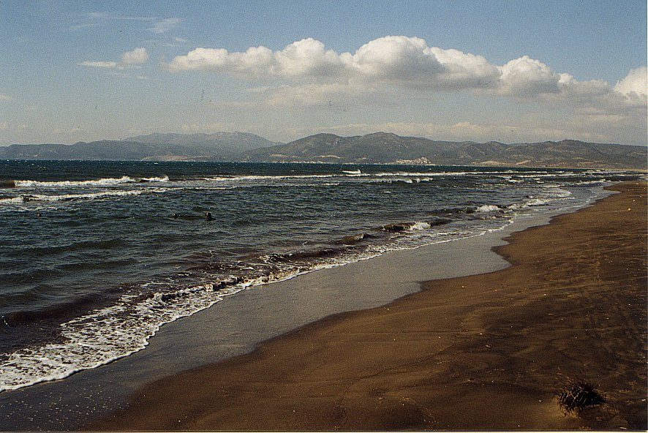
Features of the shoreline
A shoreline is the point at which a body of water meets the land.
Notes:
Point out the shoreline and barrier islands

Slide 5
What do waves do to a shoreline?
Waves- their powerful force is constantly eroding and shaping shorelines

Slide 6
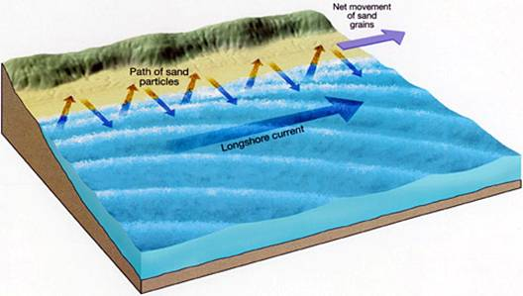
What do waves do to a shoreline?
Deposition by a longshore current creates sand bars or barrier islands like the Outer Banks.

Slide 7
Longshore Current

Slide 8
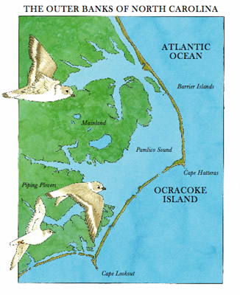
Features of the shoreline
Barrier Islands are narrow sandbars parallel to, but separated from, the coast.
Notes:
Point out the shoreline and barrier islands

Slide 9
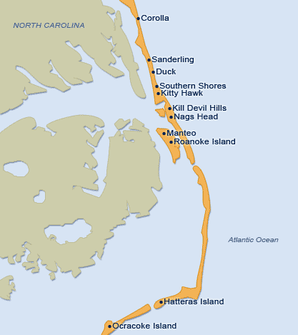

Slide 10
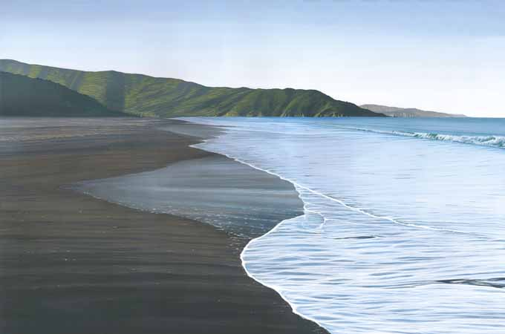
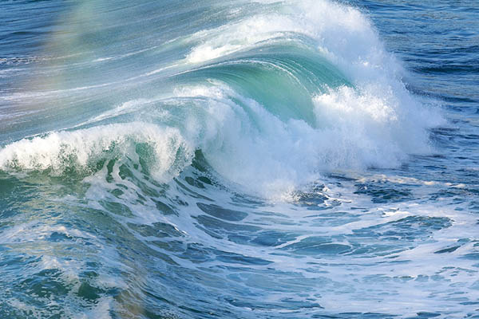
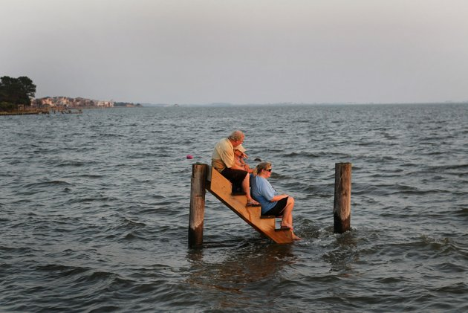
How does erosion relate to sea level rising?
Short-term causes of sea-level changes include:
Waves
Tides
Specific flood events

Slide 11
How does erosion relate to sea level rising?
Long-term causes of sea-level changes include:
Sedimentation
Changes in glaciers and ice sheets
Global warming
We will be talking about these causes more in depth in global warming unit 7

Slide 12
Case Study: Holland Island – A Disappearing Act!

Slide 13
Flip your paper: erosion on the move
http://www.discoveryeducation.com/
Follow along with the video questions
Stay in seat
No talking
This is to give you a comprehensive view of what weathering, erosion & deposition all do TOGETHER

Slide 14
Agents of Erosion
Waves create BARRIER ISLANDS
Example: Outer Banks NC

Slide 15
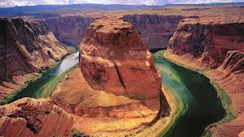
Agents of Erosion
Running Water creates Rivers & Canyons
Example: Colorado River
Created the Grand Canyon

Slide 16
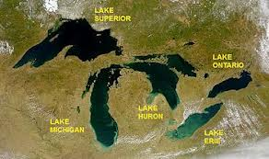
Agents of Erosion
Glaciers create Lakes & Valleys
Example: Great Lakes

Slide 17
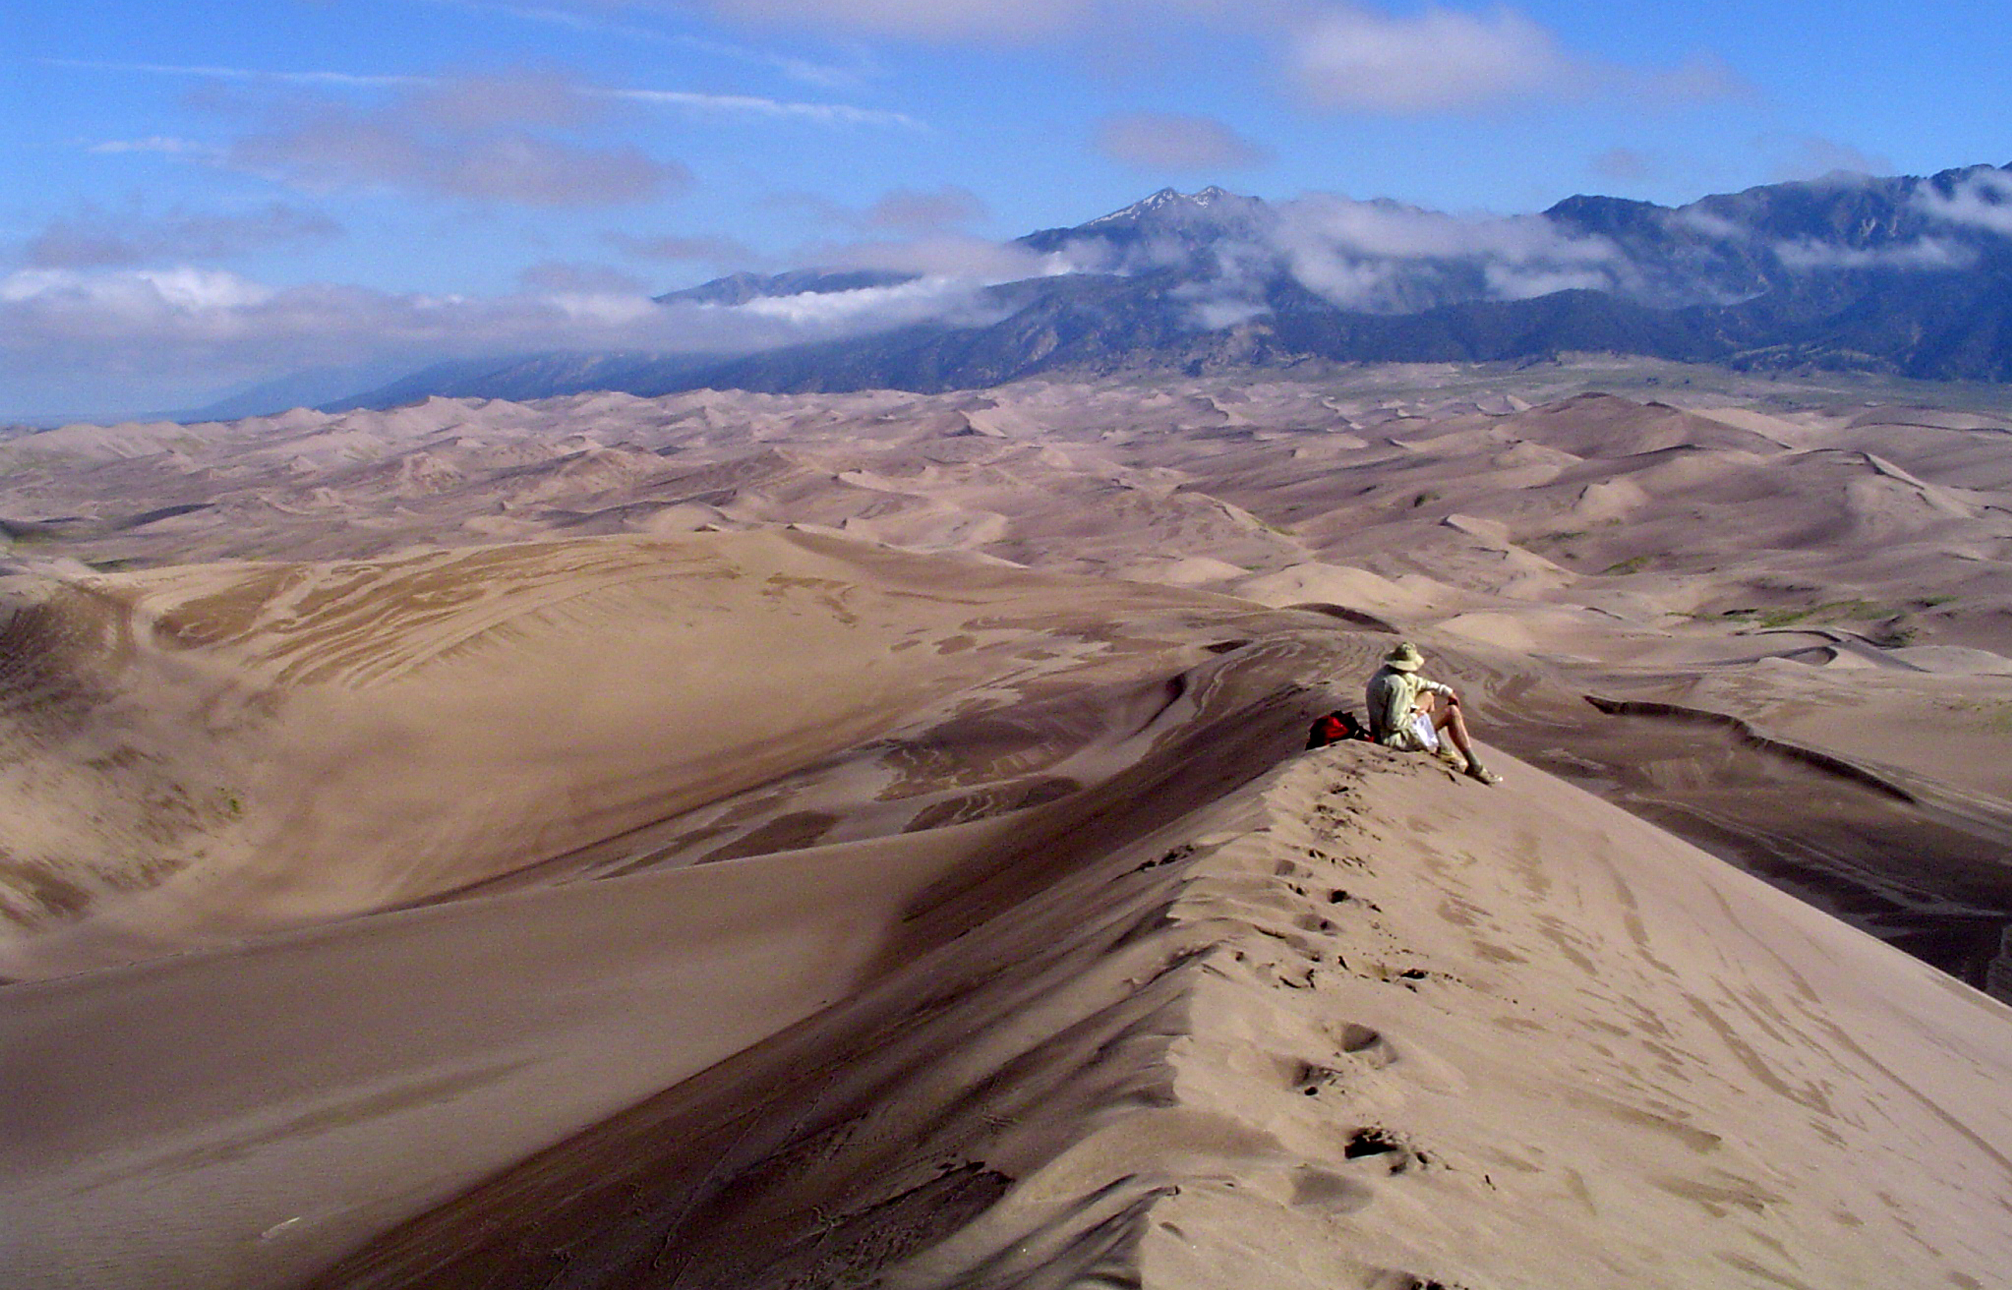
Agents of Erosion
Wind creates Sand Dunes
Example: Great Sand Dune
National Reserve & Park, CO

Slide 18
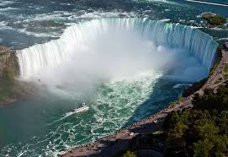
Agents of Erosion
Gravity creates landslides & water falls
Example: Niagara falls

Slide 19
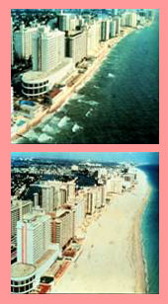
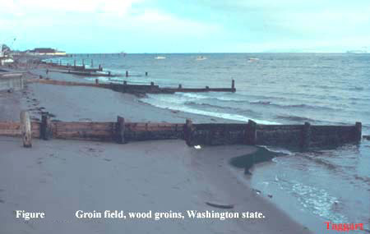
What must be done to protect our shorelines?
Groins: barrier built at a right angle to the beach to trap sand that is moving parallel to the shore.
Beach nourishment: adding large quantities of sand to the beach system
Notes:
Beach nourishment: very expensive, because large volumes of sand must be brought to the shoreline from offshore areas. Detrimental to local marine life (Waikiki Beach, HI: sand brought in was of a softer, muddier consistency and added a lot of cloudiness to the water, resulting in the death of many coral reefs).
Before & after picture of beach nourishment (Miami, FL – maybe??)

Slide 20
Wheat Residue
Farmers use it to prevent wind damage to soil

Slide 21
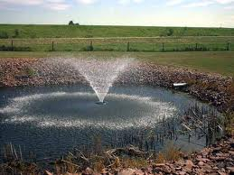
Retention Ponds
Used to collect run off in urban areas

Slide 22
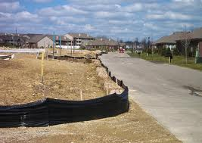
Silt Fence
Used in construction sites to prevent movement & deposition of sediments

