Slide 1
PUTTING IT ALL TOGETHER!
WHY ARE WE LEARNING THIS?
SWBAT identify the layers of the Earth by name, composition, thickness & density
SWBAT explain the 3 different movements of tectonic plates & the mechanism causing such movements.

Slide 2
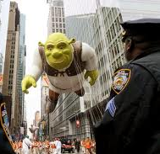
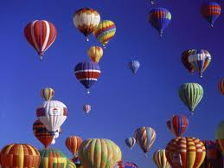
Critical Thinking
INFER: What makes hot air balloons rise??
We will come back to this

Slide 3
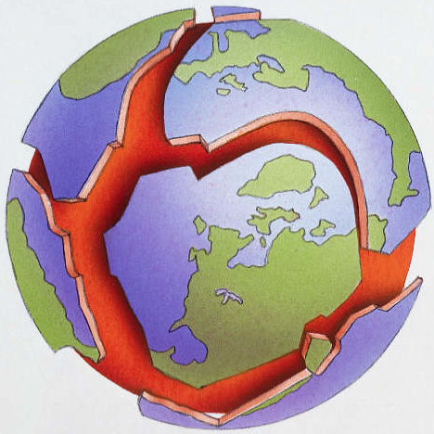
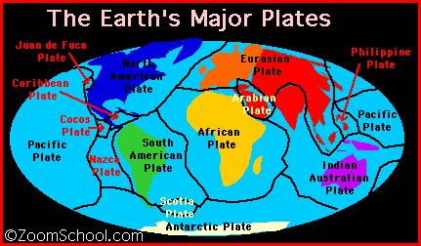
Convection Currents
The entire surface of the earth is divided into tectonic plates that are constantly moving. But how do they move??

Slide 4
Eureka!
Mantle Video http://www.youtube.com/watch?v=p0dWF_3PYh4

Slide 5
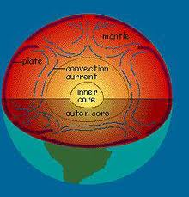

Slide 6
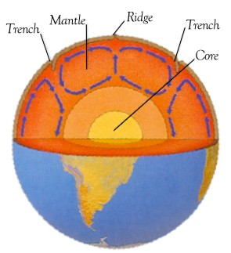
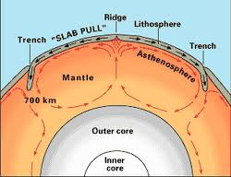
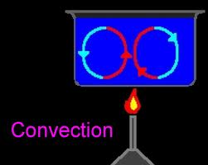
Convection
The transfer of heat in the asthenosphere due to unequal heat from the core as magma heats up and rises, then cools down and sinks
Moves the tectonic plates

Slide 7
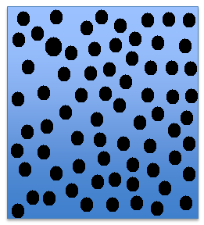
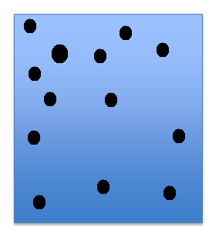
Density
Which box is more dense?

Slide 8
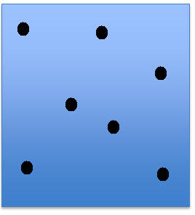
Now, which is more dense?

Slide 9
So, what exactly is density?
Density is the mass per unit volume
In other words…
The number of particles in a certain amount of space

Slide 10
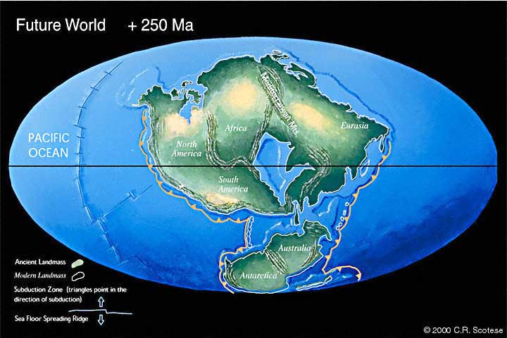
FAST FACT
The continents are moving at approximately the rate that your fingernail grows, and scientists predict that in 250 million years, another Pangaea will form when all the continents once again collide.

Slide 11
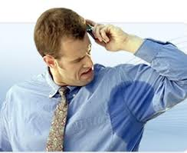
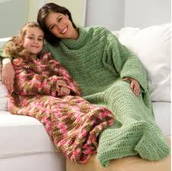
Where would you want to be? Cold vs. hot

Slide 12
Same goes for particles
How do particles change when they are cold and hot?
THEREFORE:
Hotter objects are ___________ dense and colder objects are ____________ dense.
Cold objects: More dense
Hotter particles
Colder particles
Warm objects: Less Dense

Slide 13
Earth’s Layers Diagram
Use guided notes to label & color diagram
Stay in assigned seats, talk quietly
When you finish- work on vocabulary
This is a resource tool for unit 4

Slide 14
Exit Ticket
1. What is convection?
2. In which layer does convection take place?
3. What is the heat source for convection?
4. What layer makes up the tectonic plates?
5. What layer of the earth is the most dense?
6. What layer of the earth is the least dense?

