Slide 1
Objective and Agenda
SWBAT explain how plates move and create resultant land forms.
SWBAT explain the movement of tectonic plates at different boundaries.
Homework:
Boundary Activity (class work)
Due Tuesday 3/18

Slide 2
Haste (noun)
NOUN = excessive speed or urgency of movement or action; hurry
EX - working with feverish haste
ADJECTIVE (hasty) = done or acting with excessive speed or urgency; hurried
EX - a hasty attempt to defuse the situation
archaic = quick-tempered.
VERB (hasten) = be quick to do something
EX - He hastened to refute the assertion.

Slide 3
So, what exactly is density?
Density is the mass per unit volume
In other words…
The number of particles in a certain amount of space

Slide 4
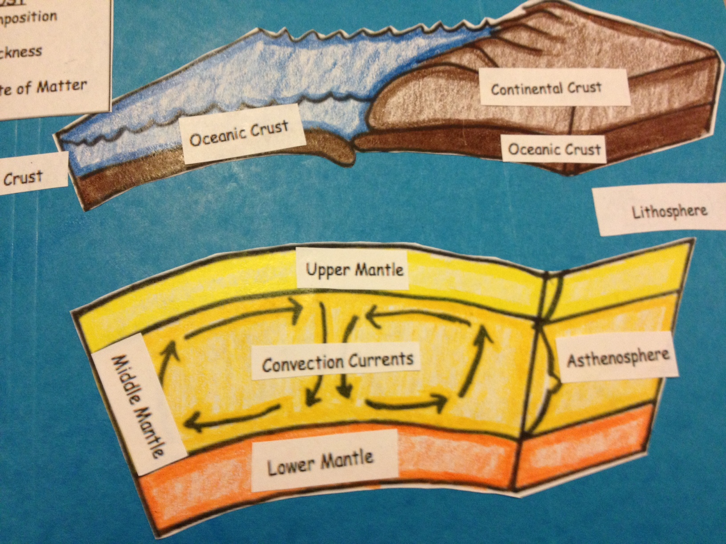
LITHOSPHERE
What is it?
Combination of BOTH Crust & Upper Mantle

Slide 5
ASTHENOSPHERE
What is it?
Combination of BOTH MIDDLE & LOWER Mantle

Slide 6
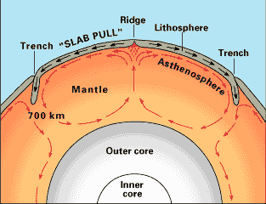
Convection Currents
The magma in mantle (beneath the crust) moves in a circular motion due to the heating and cooling of the magma.

Slide 7
A. What is plate tectonics?
The idea that the lithosphere is divided into pieces called plates that are always moving and changing size and shape.
Here is what they found…
1. There was a variation of heat flow on both sides of the Mid-Ocean ridge

Slide 9
2. The crust is broken into 15 plates
3. Movement results from activity at plate boundaries
4. Energy comes from convection
* Hot, less dense magma rises and cool, more dense earth sinks.
The constant “pull” and “push” of the rising and sinking magma forces plates to move.

Slide 10
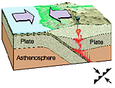
CONVERGENT BOUNDARY
Plate Movement: | Effect on Lithosphere: | Associated Geologic Features: | Real World Examples:
move together, often forcing one plate beneath the other | Lithosphere is destroyed | Subduction Zones (Ocean Trench), Volcanoes, Mountains | Himalayan Mountains, Hawaiian Islands

Slide 11
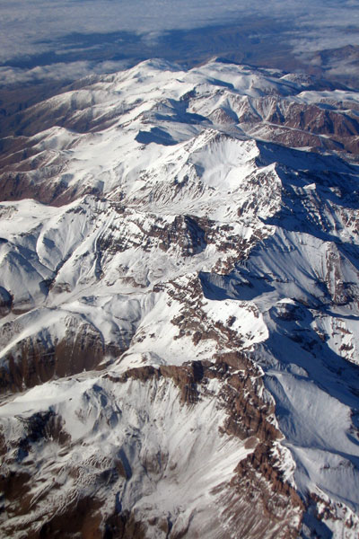
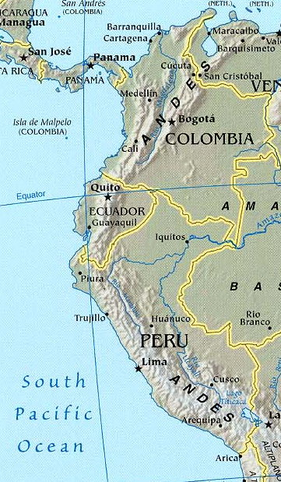
1. Subduction: when one plate sinks below the other.

Slide 12
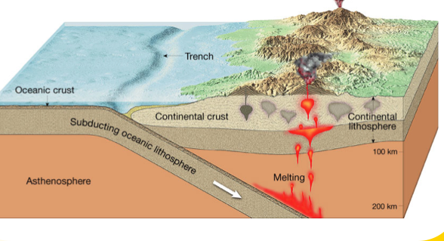
Oceanic-Continental
i. When an oceanic plate and a continental plate collide, the denser oceanic plate sinks below the less dense continental plate = trenches

Slide 13
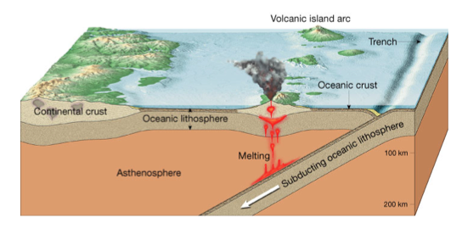
Oceanic-Oceanic
When 2 oceanic plates crash into each other, one is subducted and volcanic island arcs are formed.

Slide 14
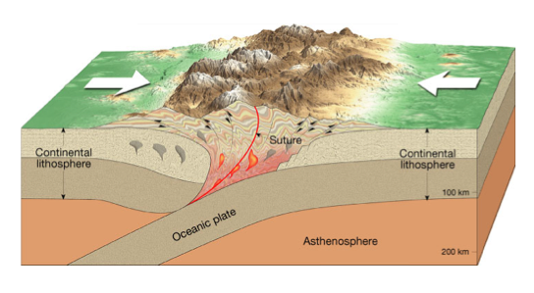
Continental-Continental
When 2 continental plates collide, the lithosphere can crumple up to form mountain ranges.

Slide 15
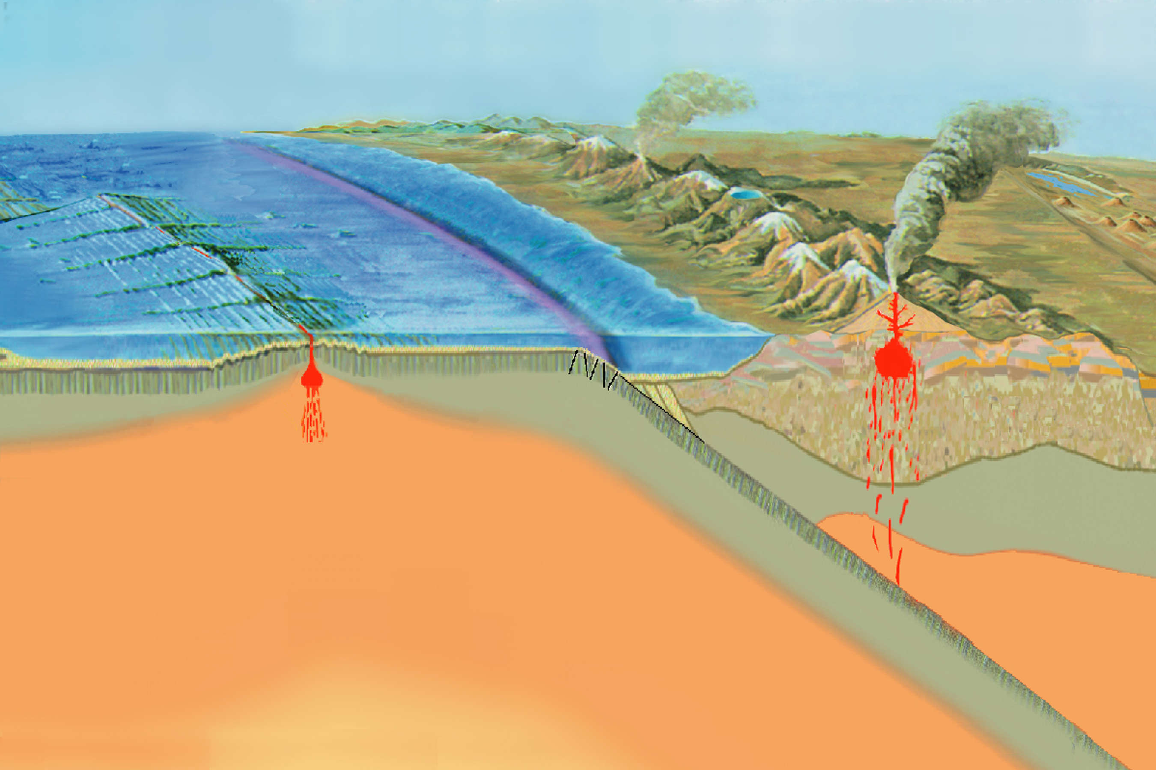
CONVERGENT BOUNDARY!
Mountain Range/
Volcano
Ocean Trench
Subduction Zone
Oceanic Lithosphere
Is destroyed (melts
Into magma)

Slide 16
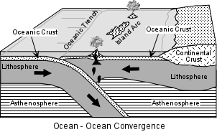
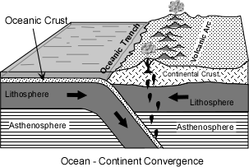

Slide 17
DIVERGENT BOUNDARY
Plate Movement: | Effect on Lithosphere: | Associated Geological Features: | Real World Examples:
Plates move apart, rift (separate) | New lithosphere is created; rising magma cools on the ocean floor | Mid-Ocean Ridge, Rift Valley; *Sea floor spreading (produces new oceanic lithosphere) | Pacific Ocean Ridge

Slide 18
DIVERGENT BOUNDARY!
Mid-Ocean Ridge
Rising magma
Convection Currents in the Asthenosphere

Slide 19
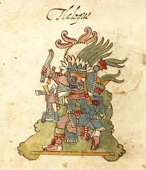
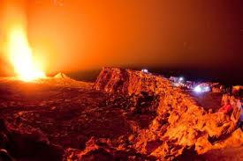
FAST FACT
Hundreds of years ago, the Aztecs of Mexico and the people of Nicaragua believed gods lived in lava lakes. They would sacrifice beautiful young girls to these powerful gods. Even well into the Middle Ages, many believed volcanoes were entrances into the fiery underworld

Slide 20
TRANSFORM FAULT BOUNDARY
Plate Movement: | Effect on Lithosphere: | Associated Geological Features: | Real World Examples:
Plates grind past each other | Neither created nor destroyed | Earthquakes | San Andreas Fault in California

Slide 21
TRANSFORM FAULT BOUNDARY!

Slide 22
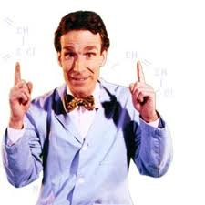
Ask and you shall receive… BILL NYE the Science Guy
http://science.discovery.com/videos/100-greatest-discoveries-shorts-plate-tectonics.html (2 min)
http://www.youtube.com/watch?v=ryrXAGY1dmE (1:15)

Slide 23
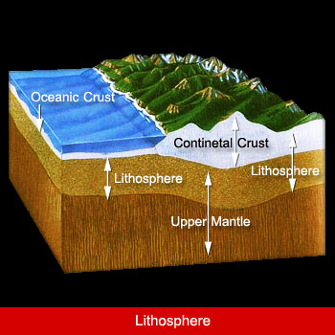

Slide 25
What is the evidence for plate tectonics?
Earthquake patterns
Paleomagnetism: the Earth has different polarities at the north and south pole and it is the natural remnant magnets in rock bodies
Normal polarity: when rocks show the same magnetism as the present magnetic field
Reverse polarity: when rocks show different magnetism as the present magnetic field
Alternating polarity is the some of the strongest evidence

Slide 26
Ocean drilling: allowed us to see dating of ocean ridge formations
Hot spots: maps seafloor spreading and shows dating

Slide 27
WHAT
1=Transform
2=Convergent
3=Divergent
TYPE
OF BOUNDARY?

Slide 28
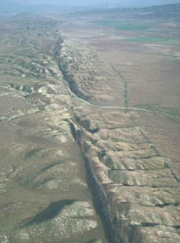
WHAT
TYPE
OF BOUNDARY?
The picture below shows the San Andreas fault in California. Many earthquakes occur here. What type of fault is this?
B=Transform
C=Convergent
D=Divergent
1=Transform
2=Convergent
3=Divergent

Slide 29
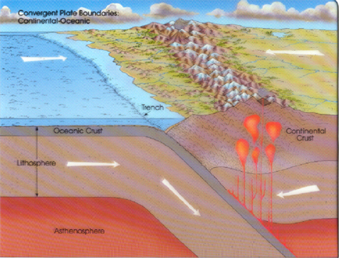
WHAT
TYPE
OF BOUNDARY?
B=Transform
C=Convergent
D=Divergent
1=Transform
2=Convergent
3=Divergent

Slide 30
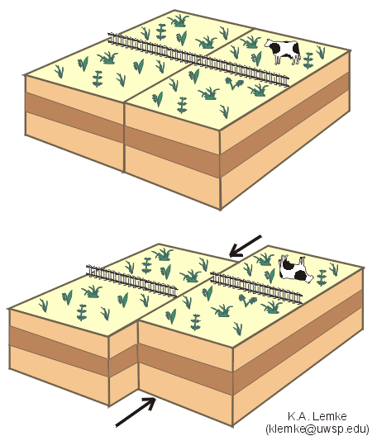
WHAT
TYPE
OF BOUNDARY?
B=Transform
C=Convergent
D=Divergent
1=Transform
2=Convergent
3=Divergent

Slide 31
WHAT
TYPE
OF BOUNDARY?
What type of boundary leads to the destruction of lithosphere?
B=Transform
C=Convergent
D=Divergent
1=Transform
2=Convergent
3=Divergent

Slide 32
WHAT
TYPE
OF BOUNDARY?
What type of boundary leads to the formation of lithosphere?
B=Transform
C=Convergent
D=Divergent
1=Transform
2=Convergent
3=Divergent

Slide 33
WHAT
TYPE
OF BOUNDARY?
What is indicated by the arrow below?
1=Ocean Trench
2=Mid-Ocean Ridge
3=Volcano

Slide 34
WHAT
TYPE
OF BOUNDARY?
What type of boundary neither forms or destroyse lithosphere?
B=Transform
C=Convergent
D=Divergent
1=Transform
2=Convergent
3=Divergent

Slide 35
WHAT
TYPE
OF BOUNDARY?
Which layer of the earth is the smiley face on?
1=Lithosphere
2=Asthenosphere
3=Core

Slide 36
WHAT
TYPE
OF BOUNDARY?
In which layer does the process shown below (convection) occur?
1=Lithosphere
2=Asthenosphere
3=Core

Slide 37
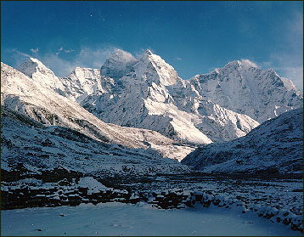
WHAT
TYPE
OF BOUNDARY?
What type of boundary formed the mountains in the picture below?
B=Transform
C=Convergent
D=Divergent
1=Transform
2=Convergent
3=Divergent

Slide 38
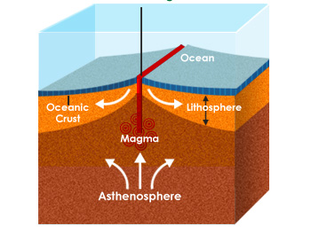
WHAT
TYPE
OF BOUNDARY?
What type of boundary is shown in the picture below?
B=Transform
C=Convergent
D=Divergent
1=Transform
2=Convergent
3=Divergent

Slide 39
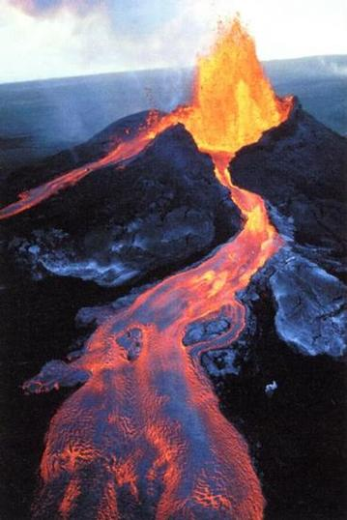
WHAT
TYPE
OF BOUNDARY?
What type of boundary formed the volcano in the picture below?
B=Transform
C=Convergent
D=Divergent
1=Transform
2=Convergent
3=Divergent

Slide 40
Challenge Question #1:
If new lithosphere is being formed in the rift, what should be true about the age of the lithosphere as you get farther away from the rift?

Slide 41
Challenge Question #2
We’ve talked about lithosphere being created (through divergent movement) and destroyed (through convergent movement). Does the surface area of the Earth ever change? Why or why not?

Slide 42
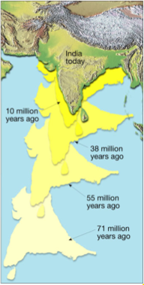
Challenge Question #3
The Himalayas were formed by India crashing into the rest of Asia. What might happen to India over the next 50 million years?

Slide 43
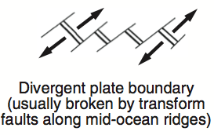
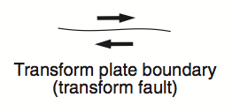
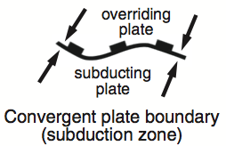
Plates Activity- Class Work Grade
The point is to recognize the different boundaries & label the different plates
First look at the KEY!
Stay seated, talk quietly, be productive

Slide 44
