Slide 1
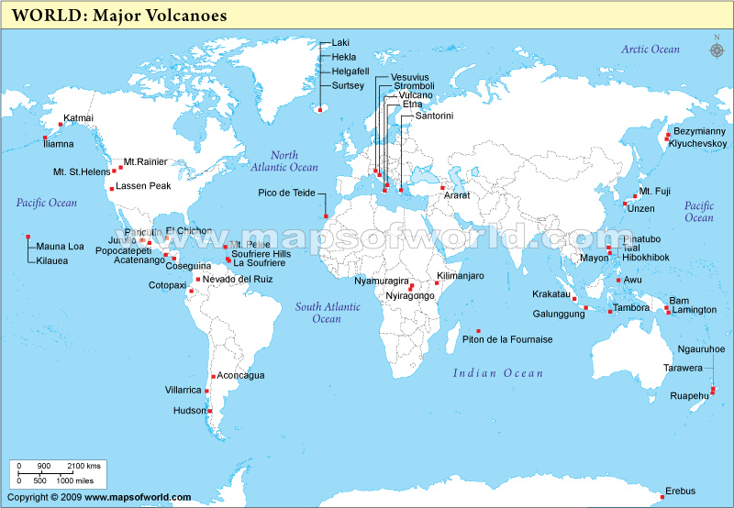
Volcanoes: SWBAT explain the formation of volcano SWBAT define vocab: viscosity

Slide 2
Map of Volcanoes around the WORLD!

Slide 3
Guided Notes
Follow along with pen/pencil
Raise hand for questions or permission to get up
Heads up, stay seated
No bathroom passes

Slide 4
Current Event – VOLCANIC EXPLOSION!
Cleveland Volcano!
In Alaska!
52 degrees North, 169 degrees West (where is it?!) – REVIEW!
Summit Elevation – 5676 ft.
http://www.avo.alaska.edu/

Slide 5
What is the difference between magma and lava?
REVIEW: What is the type of rock that forms when magma cools and hardens?
What type of rocks forms when lava cools and hardens?
THEY ARE BOTH TYPES OF IGNEOUS ROCK! What’s the difference?! –Think location…

Slide 6
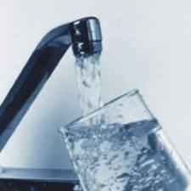
How a volcano erupts is based on viscosity.
What is viscosity?
Viscosity is how resistant a substance is to flowing. For example, honey is more viscous than water.
Magma that contains more silica will be more viscous, magma that contains less silica will be less viscous.

Slide 7
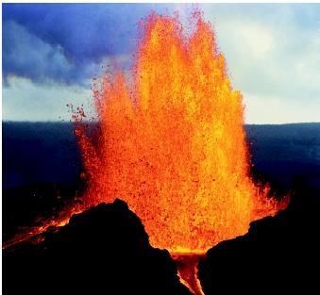
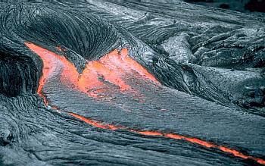
Magma that is very viscous will explode, magma that is less viscous will flow.
Lava that is hotter will be less viscous (like if you heat up honey) and will flow more.
Lava contains dissolved gases, and if the lava is very viscous, those bubbles cannot expand. Instead, the bubbles will explode upwards.

Slide 8
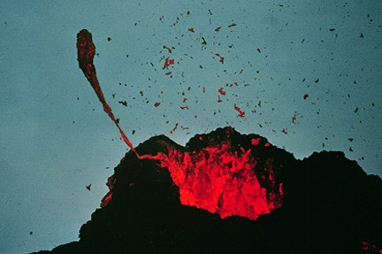
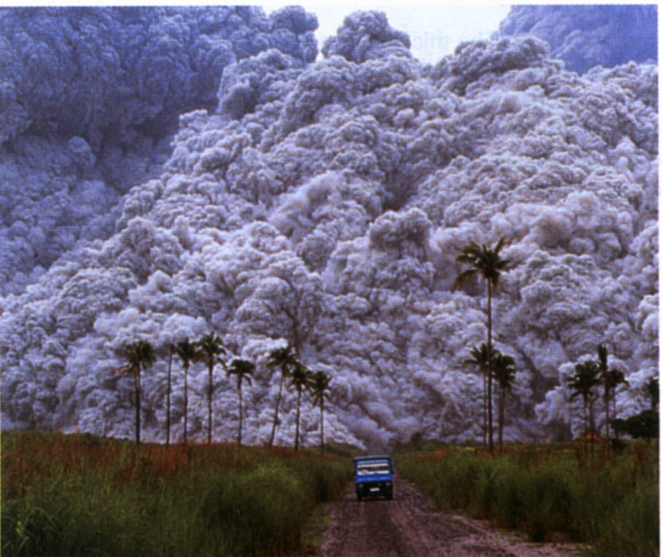
Volcanoes also eject pyroclastic materials, which is a fancy name for particles.
These particles can be as small as ash or as large as boulders.

Slide 9
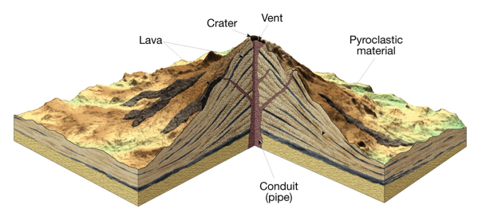
There are 3 main types of volcanoes, but they all have this general form:

Slide 10
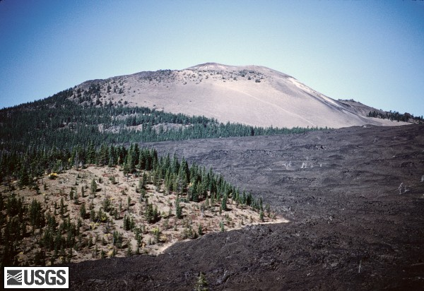
Shield Volcanoes
Made of very fluid lava that spread really far and hardened.
Broad shape
Lots of island volcanoes (for example, Hawaii)
Eruptions are not very violent

Slide 11
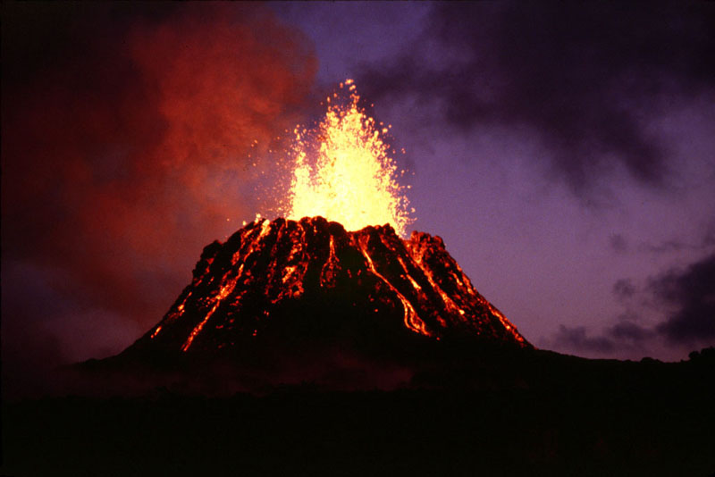
Cinder cone volcanoes
Ejects lots of cinders (chunks of pyroclastic material) that accumulate at the bottom.
Steep sides
Short lifespan (usually only erupt once).
Usually pretty small

Slide 12
Composite cone volcanoes
Huge!
Produce both lava and pyroclastic material that can reach up to 120 mph!
Usually found in the Ring of Fire, which is a zone of volcanoes that circles the Pacific Ocean.
Can sometimes form lahars, which are mudflows that are made when lava mixes with water and soil.

Slide 13
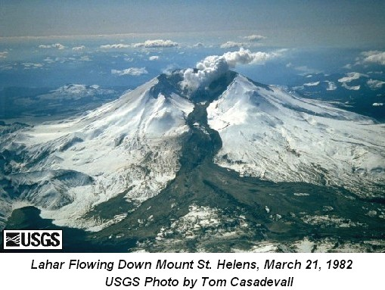
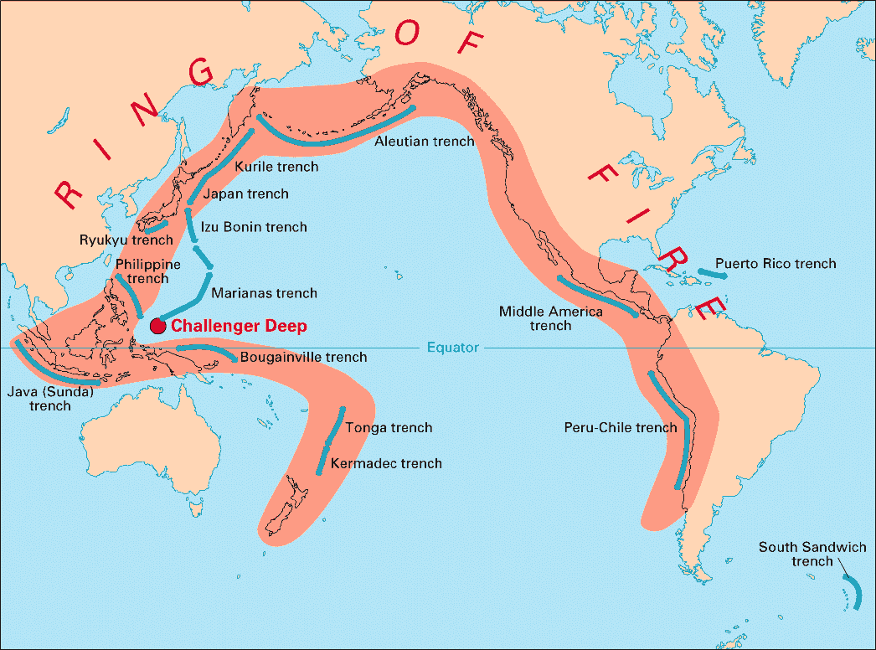

Slide 14
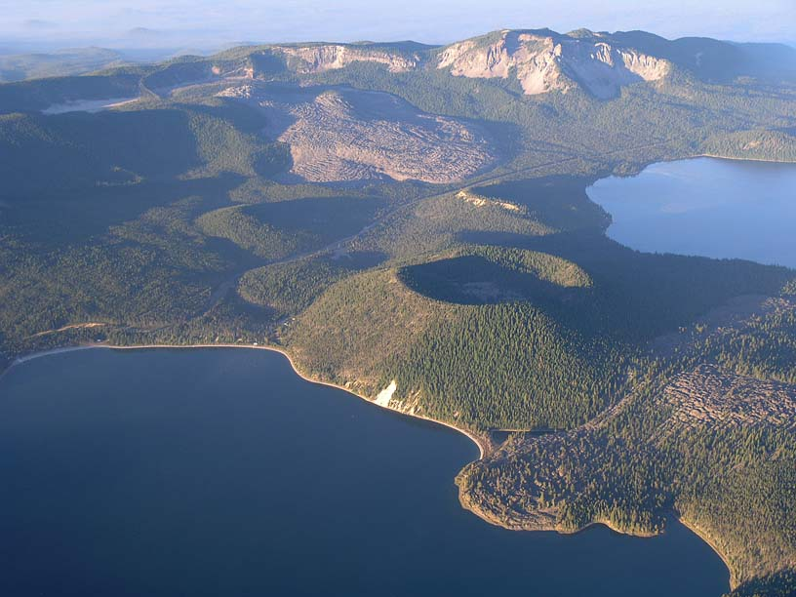
Calderas
Calderas are volcanic depressions that are created when the magma chamber is drained and the volcano collapses in on itself. Instead of looking like a mountain, it looks like a valley.

Slide 15
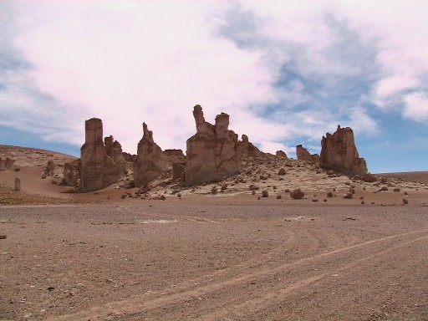
Volcanic necks
Volcanic necks are formed when a volcano has been weathered down so that only the magma conduit (pipe) is left.

Slide 16
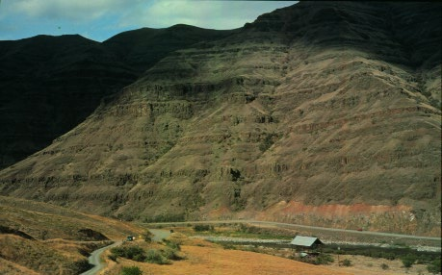
Lava Plateaus
Lava plateaus are made from very low-viscosity lava flowing out of a fissure (crack) in the ground. The lava spreads really far and creates a flat landform.

Slide 17
Guided Practice
Work on the questions on the back of your guided notes
Stay seated, talk quietly, use new information
Apply your knowledge & test your knowledge

Slide 18
Gallery Crawl!
Students stay seated & articles will MOVE to you
Need 1 peer to read aloud each time
Everyone reads twice
Stay focused, stay seated, talk quietly (group only)
If you finish early work on independent practice

Slide 19
Guided Practice
Work on the questions on the back of your guided notes
Stay seated, talk quietly, use new information
Apply your knowledge & test your knowledge

Slide 20
EXIT TICKET :
What is viscosity?
Draw & describe each volcano:
Shield
Cinder cone
Composite cone

