Slide 1
Warm Up
1. Make a T chart THEN list examples of:
-Renewable energies
-Nonrenewable energies
2. Name 1 advantage & 1 disadvantage of using coal
3. Name 1 advantage & 1 disadvantage of using solar energy

Slide 2
Objective
SWBAT explain how and why we use fossil fuels
Agenda:
Warm Up
Objective
Energy Gallery Crawl
Exit Ticket
Group Work
Group Roles
Reading + Content
Poster Creation
Gallery Crawl
Exit Ticket
Homework:
None

Slide 3
Announcements
We are starting Unit 5!
We are at the halfway point!
Now it’s time to get focused for a new unit.
Grades were handed out Yesterday = class drawer

Slide 4
Do Now
1. Make a T chart THEN list examples of:
-Renewable energies
-Nonrenewable energies
2. Name 1 advantage & 1 disadvantage of using coal
3. Name 1 advantage & 1 disadvantage of using solar energy

Slide 6
Housekeeping:
Stay seated, talk quietly,
responsible headphones & technology
Get the rest of the information from
yesterday’s readings
Look @ yesterdays exit ticket if you finish early

Slide 7
Lets look @ yesterdays exit ticket

Slide 8
Quick Quiz NAME THAT ENERGY SOURCE!

Slide 9
I am a renewable source of energy that converts the sun’s radiation into other forms of energy.
Notes:
SOLAR

Slide 10
I am a renewable source of energy that converts the sun’s radiation into other forms of energy.
Solar Energy
Notes:
SOLAR

Slide 11
I am a renewable source of energy made by burning garbage, wood, crops, landfill gases, or other organic material made from plants and animals.
Notes:
BIOMASS

Slide 12
I am a renewable source of energy made by burning garbage, wood, crops, landfill gases, or other organic material made from plants and animals.
Biomass
Notes:
BIOMASS

Slide 13
I am a nonrenewable source of energy that takes millions of years to make, from the decayed remains of dead plants and animals. Methane is my main ingredient.
Notes:
NATURAL GAS

Slide 14
I am a nonrenewable source of energy that takes millions of years to make, from the decayed remains of dead plants and animals. Methane is my main ingredient.
Natural Gas
Notes:
NATURAL GAS

Slide 15
I am a renewable source of energy create by using turbines, although some people think my turbines are not visually appealing
Notes:
WIND

Slide 16
I am a renewable source of energy create by using turbines, although some people think my turbines are not visually appealing
Wind Energy
Notes:
WIND

Slide 17
I am a nonrenewable source of energy and I can be used to make several other products such as detergents, paints, and fertilizers. I have to be pumped from deep under water and because I’m so rare, I am often a reason for the start of wars.
Notes:
PETROLEUM/OIL

Slide 18
I am a nonrenewable source of energy and I can be used to make several other products such as detergents, paints, and fertilizers. I have to be pumped from deep under water and because I’m so rare, I am often a reason for the start of wars.
Oil/ Petroleum
Notes:
PETROLEUM/OIL

Slide 19
I use the heat from within the earth to harness energy, and most of my reservoirs are found around the Ring of Fire
Notes:
GEOTHERMAL

Slide 20
I use the heat from within the earth to harness energy, and most of my reservoirs are found around the Ring of Fire
Geothermal
Notes:
GEOTHERMAL

Slide 21
I am the most abundant fossil fuel.
Notes:
COAL

Slide 22
I am the most abundant fossil fuel.
Coal
Notes:
COAL

Slide 23
I am a renewable type of energy that uses dams. Although I produce very clean energy, my dams have a finite lifetime and the availability of locations to build more is limited.
Notes:
HYDROELECTRIC/WAVE POWER

Slide 24
I am a renewable type of energy that uses dams. Although I produce very clean energy, my dams have a finite lifetime and the availability of locations to build more is limited.
Hydro-power
Notes:
HYDROELECTRIC/WAVE POWER

Slide 25
A disadvantage to using me is that if a meltdown occurs, I can have very harmful effects on human health and the environment. However, since I use uranium, I don’t emit any air pollution or carbon dioxide.
Notes:
NUCLEAR

Slide 26
A disadvantage to using me is that if a meltdown occurs, I can have very harmful effects on human health and the environment. However, since I use uranium, I don’t emit any air pollution or carbon dioxide.
Nuclear Energy
Notes:
NUCLEAR

Slide 27
Many are concerned with the environmental impact that strip-mining and underground mining for me may have.
Notes:
COAL

Slide 28
Many are concerned with the environmental impact that strip-mining and underground mining for me may have.
Notes:
COAL

Slide 29
Group Work Expectations
1. Every student must answer the five questions on their individual sheet.
2. Every student must discuss the content and help find information in the reading.
3. Students will have a specific role to help their group organize, synthesize and display the information.

Slide 30
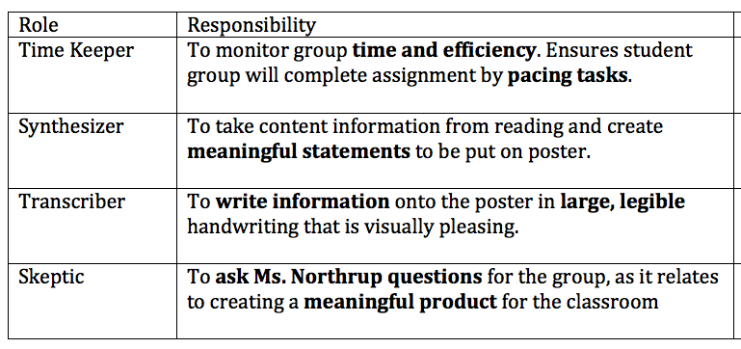
Roles = 1 per student

Slide 31
1st step = choose a role for the poster

Slide 32
2nd step = read + answer questions
Group Petroleum = 1-5
Group Gas = 6-10
Group Coal = 11-15

Slide 33
3rd step = create a poster to display information
Organize, synthesize and display the information that answers each of your questions

Slide 34
4th step = students read posters for information
Students will answer each section of questions using the created posters

Slide 36
