Slide 1
Warm Up
1. Name 3 things you did over break.
2. Make a T chart & list examples of:
-Renewable energies
-Nonrenewable energies
3. Name a perpetual resource.

Slide 2
Agenda Objective
Do Now
Energy Crisis Video
Alternative Energy Jigsaw
Carbon Footprint
Exit Ticket
SWBAT analyze the advantages and disadvantages of each ALTERNATIVE energy source.
SWBAT critically analyze which energy source is best for North Carolina.

Slide 3
Energy Assignments
Alternative Energy Jigsaw– due Apr 15 (tues)
Mining Lab – due Apr 17 (thurs)
Unit 5 Review Guide – due Apr 18 (fri)

Slide 4
Unit Plan
Monday = Alternative Energies
Tuesday = Mining Lab
Wednesday = Human Impact on Lithosphere
Thursday = Review (assignment) Quiz
Friday = Unit 5 Test, Unit 6 Vocabulary

Slide 5
Warm Up
1. Name 3 things you did over break.
2. Make a T chart & list examples of:
-Renewable energies
-Nonrenewable energies
3. Name a perpetual resource.

Slide 6
Clear Your DESK ☺
Watch video and follow along with questions
http://app.discoveryeducation.com/search?Ntt=energy+crisis

Slide 7
What is the energy crisis?
Watch video and follow along with questions
http://app.discoveryeducation.com/search?Ntt=energy+crisis

Slide 8
Alternative Energy Jigsaw
There are four readings that correspond to your guided questions
You will choose 1 partner
You may receive the grade your partner gets = accountability
Read & discuss answers to the questions
I will be using popsicle sticks to keep everyone accountable
Passing papers effectively & transitioning quickly is important

Slide 9
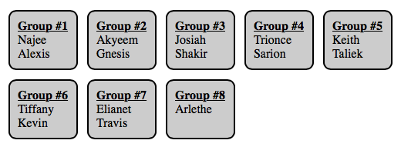
Meet your partner @ your assigned table

Slide 10
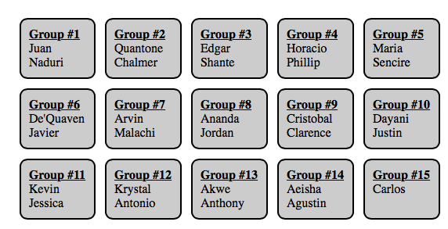
Meet your partner @ your assigned table

Slide 11
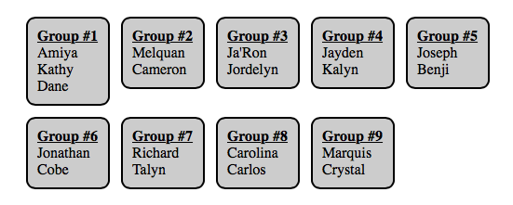
Meet your partner @ your assigned table

Slide 12
Alternative Energy Jigsaw
SOLAR Energy = Yellow
Passing papers effectively & transitioning quickly is important
Two (2) students per desk, facing forward
Talking quietly to partner only, Move only when transitioning

Slide 13
Alternative Energy Jigsaw
NUCLEAR Energy = Orange
Passing papers effectively & transitioning quickly is important
Two (2) students per desk, facing forward
Talking quietly to partner only, Move only when transitioning

Slide 14
Alternative Energy Jigsaw
WIND Energy = Red
Passing papers effectively & transitioning quickly is important
Two (2) students per desk, facing forward
Talking quietly to partner only, Move only when transitioning

Slide 15
Alternative Energy Jigsaw
HYDRO Energy = Blue
Passing papers effectively & transitioning quickly is important
Two (2) students per desk, facing forward
Talking quietly to partner only, Move only when transitioning

Slide 16
Return to Assigned Seat
Take an opportunity to talk to seat partner about any questions you are missing
Hand into “Exit Ticket” box @ bell
Have a great day!

