Slide 1
Warm Up = fossil fuels (oil, coal, gas)
Which energy is....
best for electricity?
most abundant?
used for heating?
for transportation?
mined?
drilled?
Challenge!
7. How is coal formed?
8. How is oil/gas formed?

Slide 2
Objective
SWBAT illustrate advantages and disadvantages of fossil fuels
Agenda:
Warm Up
Objective
Reflection
Venn diagram
Mini posters
Kahoot
Homework:
Have Fun and return fresh & ready to finish the year!

Slide 3
Announcements
We made it to the 4th quarter!

Slide 4
Warm Up = fossil fuels (oil, coal, gas)
Which energy is....
best for electricity?
most abundant?
used for heating?
for transportation?
mined?
drilled?
Challenge!
7. How is coal formed?
8. How is oil/gas formed?

Slide 6
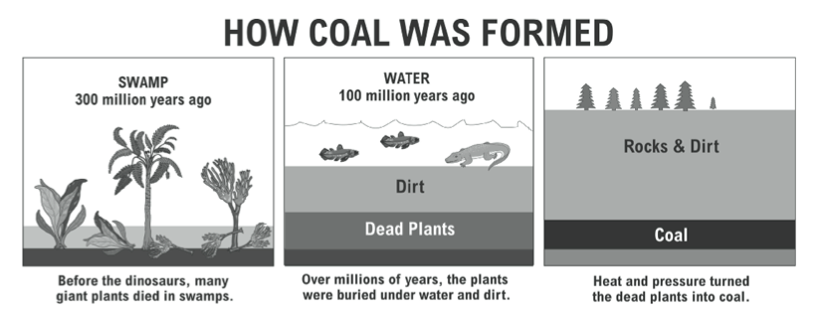

Slide 7
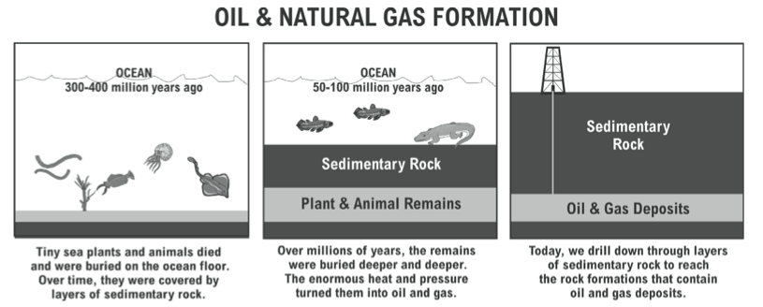

Slide 8
Weekly Reflection
Positive from your week: I give a rose to a playing bball, hopefully I can make my foul shots this year!
Neutral from your week: I give a stem to being an my lifeguard training classes during spring break because it will be good exercise but I cannot sleep in
Negative from your week: I give a thorn to grading because I want it to help students but it doesn’t seem that way sometimes.

Slide 9
Hand in Warm Up
Pass it over to the LEFT

Slide 10
You will receive yesterday’s class work
Clear your desk

Slide 11
Coal
Natural Gas
Petroleum

Slide 12
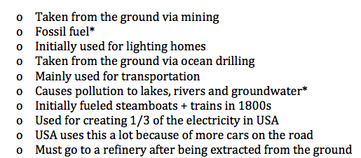
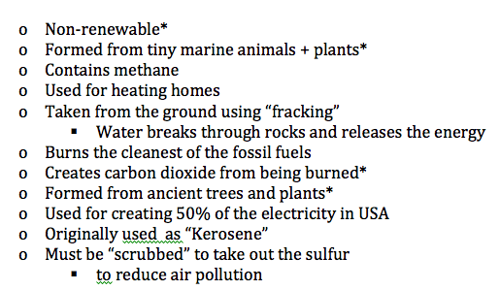

Slide 13
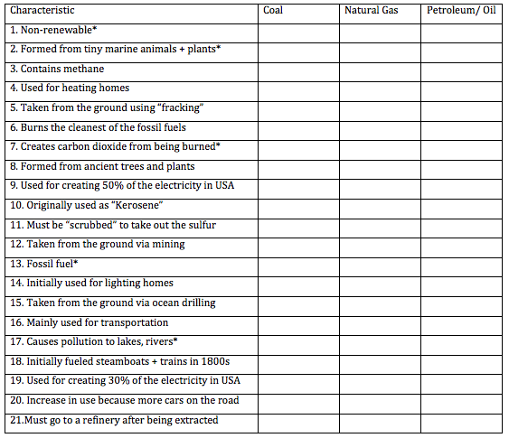

Slide 14
Independent Practice:
Stay seated, Talk quietly with partner,
Headphones ok, Responsible phones
(no games, or excessive social media)
Synthesize your learning on fossil fuels
Essential Questions:
1. What was the fuel used for in the past?
2. What do we use the fuel for today?
3. How was the fuel formed?
4. How is the fuel extracted from the ground?
5. What impact does it have on the environment?
6. What is the future outlook for this fuel?

Slide 15
Warm Up = fossil fuels (oil, coal, gas)
Which energy is....
best for electricity?
most abundant?
used for heating?
for transportation?
mined?
drilled?
Challenge!
7. How is coal formed?
8. How is oil/gas formed?

