Slide 1
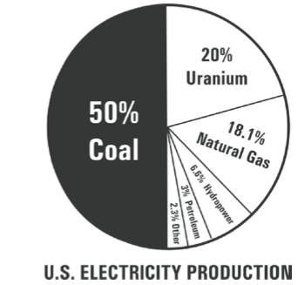
Do Now
Draw three examples to describe how humans impact the lithosphere.
Name a negative impact for the following human activities.
Make two observations
about this pie chart.

Slide 2
Agenda Objective
Do Now
Objective
Housekeeping
Review Friday’s Quiz
Checks for Understanding
Scavenger Hunt
Student Bingo
Independent Review
Unit 5 Quiz II
SWBAT review Unit 5 content for Assessment
Homework:
1. Pink Review Sheet
2. Honors Review

Slide 3
Housekeeping
FIVE minutes
Hand in today’s assignments DUE Mon Apr 20
Tues = Mining Lab + paragraph
Friday = 9 questions on back of class work
If finished:
Pink Review Sheet
Honors Review Questions
Unit 5 Crossword

Slide 4
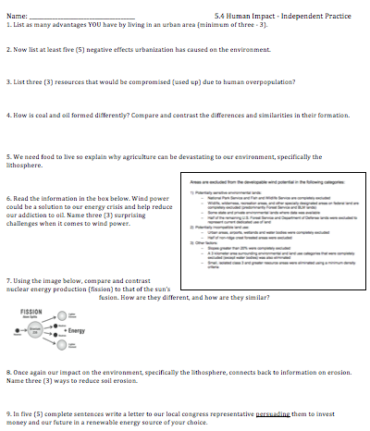
Priority:
Mining lab
Fridays class work

Slide 5
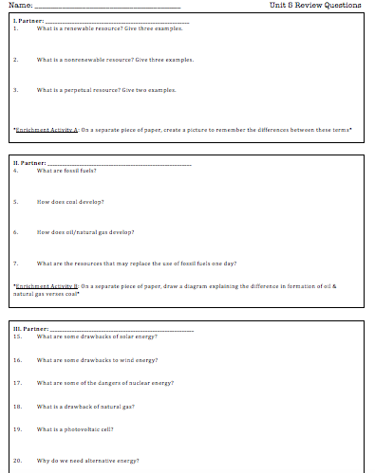
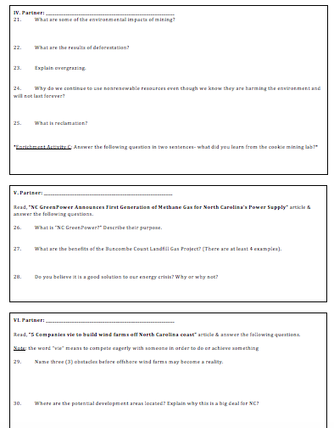
Work on this if you finished:
Mining lab
Fridays class work

Slide 6
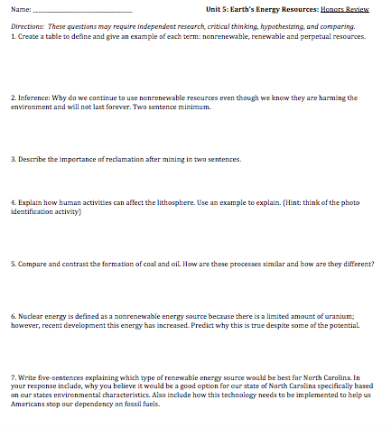
Work on this if you finished:
Mining lab
Fridays class work
Unit 5 Review Guide

Slide 7
Hand in any COMPLETED assigments into “class work” box near window
Cleared Desk

Slide 8
Yesterdays Quiz
Clear Desk
Pen/Pencil in hand
Do NOT write on green paper
When you get your quiz back,
begin reviewing your answers with your partner
Think: How can I use this quiz to begin studying for unit 5 test?

Slide 9
Student Bingo
Clear desk
When you get sheet- read tasks
Circle tasks you CAN complete
Choose your BEST five
Discuss the tasks with your seat partner

Slide 10
Scavenger Hunt
½ sheet of paper
Number 1-18
Everyone MUST participate
If you are working on HW then = -10% deduction
Walk in the classroom, talk quietly

Slide 11
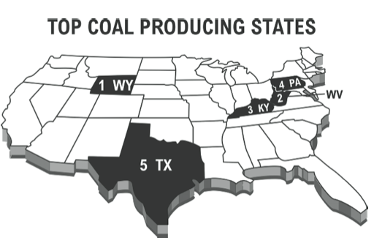

Slide 12
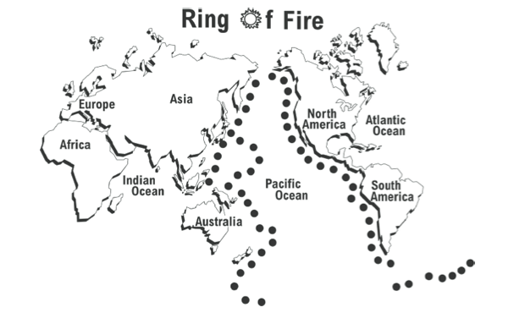

Slide 13
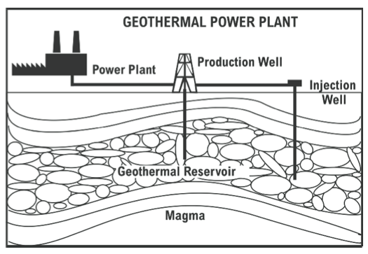

Slide 14
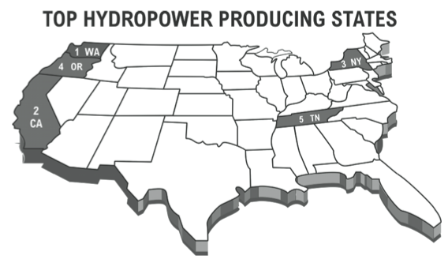

Slide 15
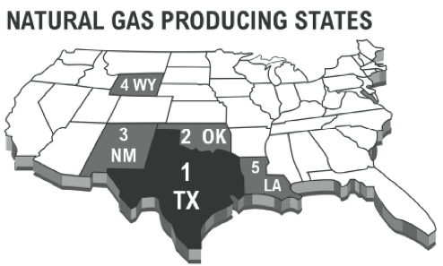

Slide 16
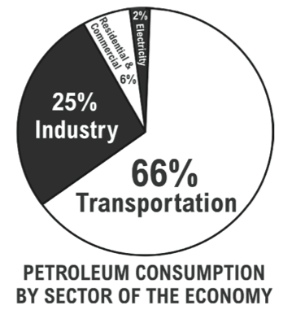

Slide 17
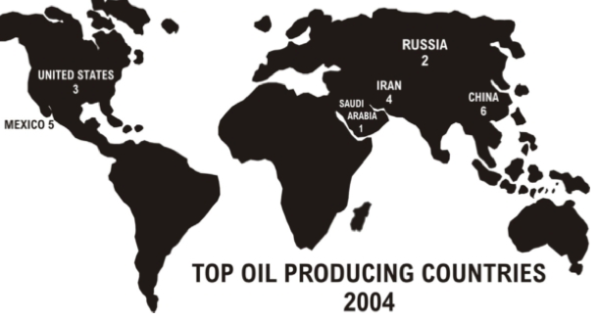

Slide 18
Student Bingo
For each letter, find one person who can complete the corresponding task.
Write each name in one of the boxes below. Be sure the student can complete each task.
If not, your box will be disqualified and it not be counted towards your bingo.

Slide 19
Student Bingo
If you sign someone’s bingo square then YOU are expected to COMPLETE activity
I will be randomly checking student’s knowledge
If you cannot answer satisfactory-
then you will have to complete the activity on paper

Slide 20
Student Bingo
Only can have 3 people per sheet
When you have BINGO = 4 boxes in a row
Return to assigned seat
Begin working on crossword
Wait quietly until timer
Talk quietly, walk in room, no phones

Slide 21
Student Bingo
Return to assigned seat
I will be randomly checking student’s knowledge
If you cannot answer satisfactory-
then you will have to complete the activity on paper

Slide 22
Yesterdays Quiz
Clear Desk
Pen/Pencil in hand
Do NOT write on green paper
When you get your quiz back,
begin reviewing your answers with your partner
Think: How can I use this quiz to begin studying for unit 5 test?

Slide 23
Independent Review
Stay Seated
Talking quietly, facing forward, responsible phones
Finish up any unanswered questions on unit 5 appointments review
This will be turned in for review guide grade
Attempt the seven questions the backside of unit 5 crossword to further your personal review
More practice the better

Slide 24
Finish up any unanswered questions on unit 5 appointments review
This will be turned in for review guide grade
Readings for 5 + 6 will be available

Slide 25
Attempt the seven questions the backside of unit 5 crossword to further your personal review
More practice the better

Slide 26
Review Appointments
This is homework if you don’t finish it
DUE Wednesday 4/9
Enrichment activities = good review activity

Slide 27
Checks for Understanding
Dear President Obama,
I want to tell you about earth’s energy sources. Did you know there are 3 main categories: 1______, renewable & 2______? The public should know more about 3______ energy because humans don’t affect it & states like NC can use the coast as a good source of energy. 4______ power is also very efficient because whole cities like Pittsburgh run off of this energy source. However there are issues with the safety of meltdowns. Battery operated energy is connected with this perpetual source of 5______ power. On its own, this source would not be effective because of clouds and its unpredictability but including batteries would be good option.

Slide 28
Fill in the Blank
Coal is made from 6________________.
This formed 7___________.
Natural gas & oil formed from 8__________.
Both of these processes use 9_________ & 10________ after sediments deposited on top.
Checks for understanding

Slide 29
Did I learn??
Coal is made from Ancient Trees & plants.
This formed Peat
Natural gas & oil formed from tiny marine animals.
Both of these processes use heat & pressure after sediments deposited on top.

Slide 30
Return to Assigned Seats
Clean Up + Clear DESK

Slide 31
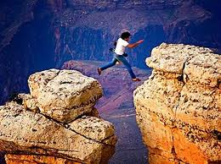
Exit Ticket
If you have a scantron- lets use it again on the BACK
No talking
Put in exit ticket box on way out of door @ bell

Slide 32
Unit 3 –Quiz
Clear your desk
Place this SYMBOL in box
No talking at ALL
When FINISHED:
Flip over scantron
Wait quietly
Put into exit ticket box @ bell

