Slide 1
Warm Up Welcome Back!
Name two things you did over break.
Did you exchange gifts?
If yes, name a gift you received.
If no, name one of your favorite meals.
Review: How does CO2 contribute to global warming?
Review: Name 2 effects global warming will have on the environment.

Slide 2
swbat analyze how air pressure affects wind patterns and cloud formation
Agenda:
Do Now
Objective
Assigned Seats
Weather Tracker
Clouds in a Bottle Video
Notes
Isobar Practice
Notes
Comprehension Check Video
Layers of the Atmosphere Practice
Exit Ticket
NO HW

Slide 3
Only 6 days until final exam
Updates:
Grades are current
I will not be grading warm ups 15 & 16 sorry for the confusion
2. Did you do the atmosphere textbook assignment?
If no, you can submit tomorrow
If yes, you can submit today
Tutoring Tues & Thurs 230-330pm
- work on testing strategies
4. Extra credit is available on the WIKI “Comprehensive Review”
-if you need me to print it out for you talk to me privately
5. Hand in late work ASAP

Slide 4
Warm Up Welcome Back!
Name two things you did over break.
Did you exchange gifts?
If yes, name a gift you received.
If no, name one of your favorite meals.
Review: How does CO2 contribute to global warming?
Review: Name 2 effects global warming will have on the environment.

Slide 5
Seat Change
If you are unhappy write me a sticky note answering the following:
Why you dislike your new seat.
Where you would prefer to sit.
Why you would prefer to sit there.
Clear your DESK

Slide 6
2.5 Understand the structure of and processes within our atmosphere.
2.5.1 Summarize the structure and composition of our atmosphere.

Slide 7
2.5 Understand the structure of and processes within our atmosphere.
2.5.2 Explain the formation of typical air masses and the weather systems that result from air mass interactions.
Write three key words from the following:
Explain how air masses move (pressure differentials).
Explain how interactions of air masses form frontal boundaries, clouds, and affect wind patterns.

Slide 8
Let’s start our Weather Tracker!!
http://www.intellicast.com/Local/Weather.aspx?location=USN0121 (Get info from this site)
For the next two weeks we will collect daily weather data
You are required to write down information
If you lose your paper then you can get another one (if there are extras) or write it down on another piece of paper
I will collect this for a class work grade

Slide 9
Guided Notes Expectations
Cleared desk
Pen/Pencil
No talking (raise a quiet hand)
No bathroom passes
Heads up (or stand for 4 minutes)

Slide 10
Cloud in a bottle video analysis
What type of liquid does Steve put into the bottle?
What does the bicycle pump add to the bottle?
What happens when the bicycle pump is released?
We see a cloud created when the system goes from _____ pressure to _____ pressure.
http://www.youtube.com/watch?v=JsnjvFy7aw8&NR=1&feature=endscreen

Slide 11
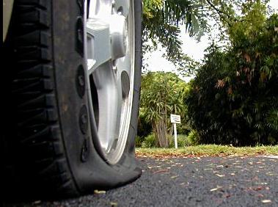
Air pressure
Pressure exerted by the weight of air above it.
Exerted in ALL directions—down, up, and sideways!
Air is pushing down on your desk, but it’s pushing up from below as well, which is why your desk doesn’t collapse.
Can change from place to place.
Measured in units called millibar.

Slide 12
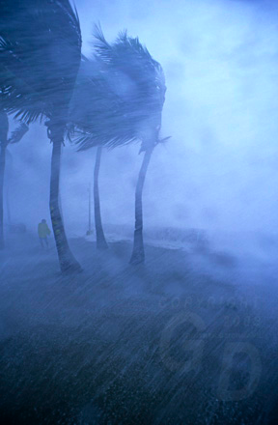
How does this relate to weather?
Differences in air pressure create winds.
Winds change temperature and humidity.
So…differences in air pressure cause weather!

Slide 13
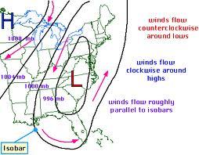
Pressure changes because the earth is heated unequally.

Slide 14
Air pressure maps:-What are isobars? -Isobars show places that have equal air pressure’ winds generally run PARALLEL to the isobars (Closter the isobars the steeper the pressure and faster the winds)

Slide 15
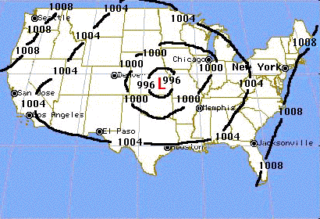
Practice Isobar Yourself!
Certain weather maps allow us to view High and Low pressure systems that control the weather.
Isobar maps show where pressures are relatively high and low, and show us where pressure changes are gradual or dramatic over a distance.

Slide 16
Practice Isobar Yourself!
Read the 7 actions & the two questions with your seat partner
We will discuss these after you read the information
Try the problems! Be brave!

Slide 17
Isobar Practice

Slide 18
Final Isobar Map

Slide 19
Isobar Practice

Slide 20
What is wind?
Wind is the horizontal movement of air.
It happens because of horizontal differences in air pressure.
Wind blows from areas of higher pressure to areas of lower pressure.

Slide 21
There are 3 things that control wind
Pressure Differences
Coriolis Effect
Friction

Slide 22
What is humidity?
The amount of water vapor that’s in the air
Water vapor is when liquid water turns into a gas through evaporation
Air can hold a certain amount of water. The amount of water it can hold depends on temperature

Slide 23
What is humidity?
Warmer air can hold a lot more water so humidity is higher (think about the summer!) and the opposite is true

Slide 24
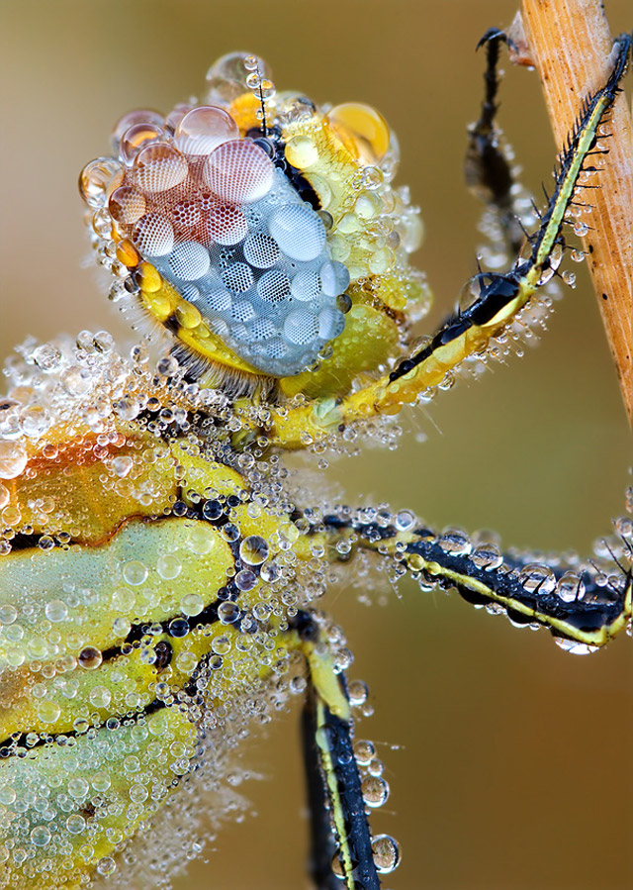
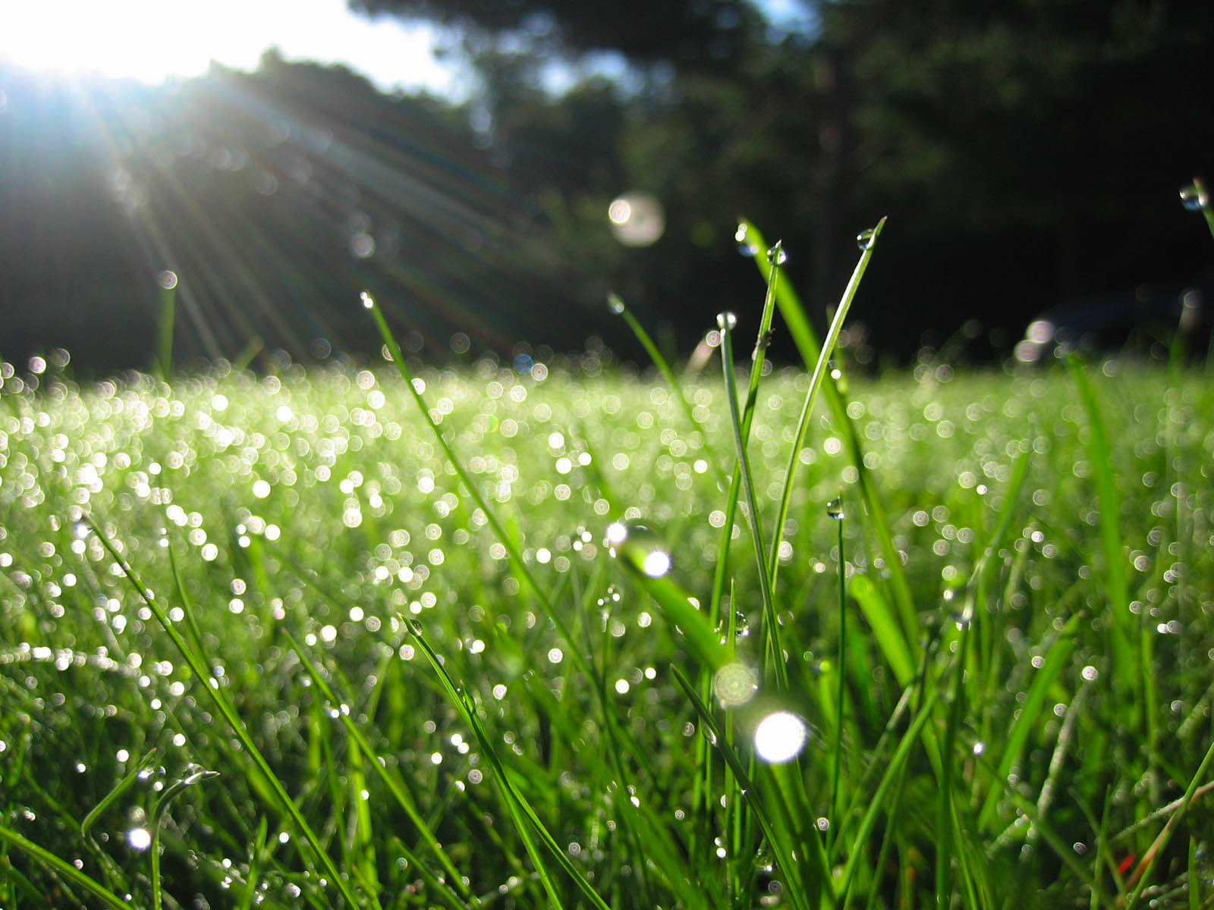
Sometimes in the morning, you walk outside and see tiny droplets of water on everything.
What is this?
Where did it come from?

Slide 25
Dew = condensed water vapor.
If air gets cool enough, it can condense to form small drops of water.
Dew point = the temperature at which water vapor will condense
So, when the air gets cool enough, the water vapor turns into liquid. Does this sound like something else that happens in the atmosphere?

Slide 26
Clouds…
As you go higher in the atmosphere there is LESS pressure.
Air then expands and cools (dry adiabatic rate)
When it cools down enough, it reaches its dew point
Once it hits the dew point, it becomes a cloud!

Slide 27
3 things needed to make a cloud:
Water vapor/humidity
Temperature difference
Condensation nuclei: tiny particles for water to condense around

Slide 28
3 things needed to make a cloud:
Humidity
Temperature difference
Condensation nuclei: tiny particles for water to condense around

Slide 29
Comprehension Check Video http://www.youtube.com/watch?v=I0C4QR0OEH0
1. We can measure atmospheric pressure with a device called a ____________________. It is a way of measuring the weight of air.
2. The weight of air is referred to as ____________________________ .
3. Air pressure is measured in units called ______________________.
4. What happens when the block on the left is heated up?
5. What happens when air is chilled?
6. Air pressure helps determine the ____________________.
7. The boudaries between high pressure systems and low pressure areas can be ______________________.
8. Wind is caused by the movement of air from a ____________ pressure to a _____________ pressure area.

Slide 30
Comprehension Check Video
1. We can measure atmospheric pressure with a device called a ____________________. It is a way of measuring the weight of air.
2. The weight of air is referred to as ____________________________ .
3. Air pressure is measured in units called ______________________.
4. What happens when the block on the left is heated up?
5. What happens when air is chilled?
6. Air pressure helps determine the ____________________.
7. The boundaries between high pressure systems and low pressure areas can be ______________________.
8. Wind is caused by the movement of air from a ____________ pressure to a _____________ pressure area.

Slide 31
Atmosphere Vocabulary Practice
Stay in assigned seat, talk quietly
Practice the definitions and information from yesterday’s & today’s lessons

Slide 32
Definition Billboards
WIND
3 Things that Control Wind
The Relationship with Pressure

Slide 33
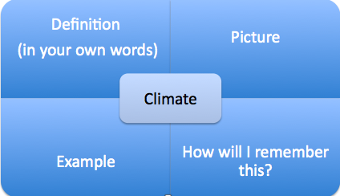
a visible mass of condensed water vapor floating in the atmosphere, typically high above the ground.
"the sun had disappeared behind a cloud”
CLOUDS
How do they form?
The Relationship with Pressure

Slide 34
Mount Everest Reading
You have the rest of class to answer the questions
This is a class work grade- so we have no hw
Skip question #4
We will do the exit ticket at the bottom

Slide 35
CLEAR Desk
Split a sheet of paper with neighbor
Get ID BADGE on
Hold on to billboards – it is a study skill for unit 8

Slide 36
Exit Ticket
What happens at the dew point?
In which direction is air pressure exerted?
What are the forces that influence wind?
What causes air to rise?

Slide 37
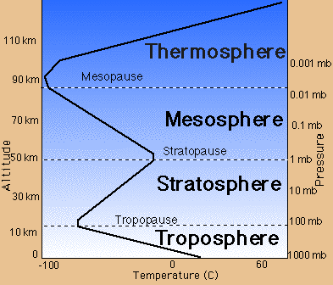
You need to be familiar with this graph- Temperature !!!!

Slide 38
Checks for Understanding
In which layer of the atmosphere, would a person experience the GREATEST air pressure
1. troposphere 2. stratosphere
3. mesosphere 4. thermosphere

Slide 39
Checks for Understanding
Which two layers of the atmosphere experience temperature INCREASES with altitude?
1. Troposphere & thermosphere
2. stratosphere & mesosphere
3. Troposphere & mesosphere
4. stratosphere & thermosphere

Slide 40
Checks for Understanding
Which two layers of the atmosphere experience temperature DECREASES with altitude?
1. Troposphere & thermosphere
2. stratosphere & mesosphere
3. Troposphere & mesosphere
4. stratosphere & thermosphere

Slide 41
Checks for Understanding
What is the first layer of atmosphere an astronaut passes through during reentry from space?
1. troposphere
2. stratosphere
3. mesosphere
4. thermosphere

Slide 42
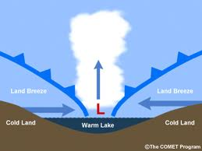
But what causes this air that forms clouds to move up?
Word | Explanation
1. Convergence | Wind runs into each other, they collide and move up

Slide 43
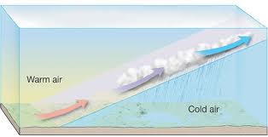
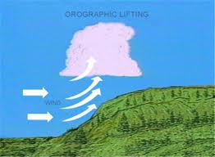
Word | Explanation
2. Frontal Wedging | 2. Over flat surfaces, when cold air and warm air meet, the warm air rises above the cold air (think density!)
3. Orographic lifting | 3. Air moves up a mountain slope and cools down, forming clouds

