Slide 1
Do Now MONDAY:
In your own words, define the following terms AND draw a quick picture of each
Rotation
Revolution
1st try without notes
then use your notes to add info

Slide 2
Astronomy
Objective
Agenda
SWBAT determine the barycenter between two objects
Warm Up
Objective
Course Update
Housekeeping
Friday’s Exit Ticket
Barycenter Lab
Conclusion
Exit Ticket
Homework
Finish Barycenter Lab
Late work ASAP

Slide 4
Do Now MONDAY:
In your own words, define the following terms AND draw a quick picture of each
Rotation
Revolution
1st try without notes
then use your notes to add info

Slide 5
Homework- Due Tuesday 9/9
Finish Barycenter Lab
- If we are on task today, you should have a good amount of time to get this completed

Slide 6
Announcements
Tutoring Tuesday 230-330pm
Please be on time
Come prepared with a plan for what you need accomplished
Opportunity to discuss your personal growth & concerns (grades)

Slide 7
Ms. Northrup’s grading
Weekend is when I focus on grading
During the week, my focus is on teaching and learning. Do not be offended if I ask to discuss your grade at another time. I have +100 students
Overall I was impressed by the level of work I saw
I have not yet put them into power school
I will do that today so tomorrow will be an opportunity to see your average

Slide 8
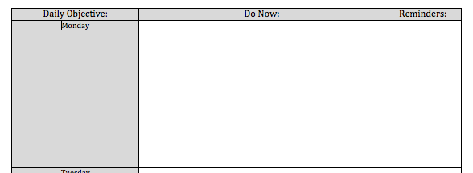
Ms. Northrup’s grading
Week Sheet
1 point for objective, 1 point for stamp
3 points for completion of warm up
3 points for reflection
If you were absent, write it, no points off

Slide 9
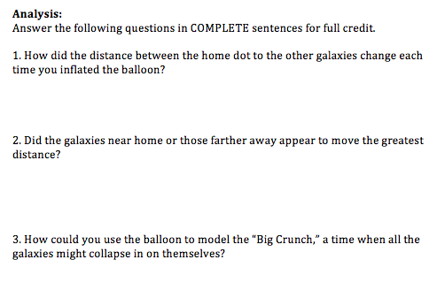
Balloon Lab
First paper of the pair = grade for both
Two parts were graded, Introduction (10 pts), Analysis questions (10 pts)
If you have a red mark then yours was graded

Slide 10
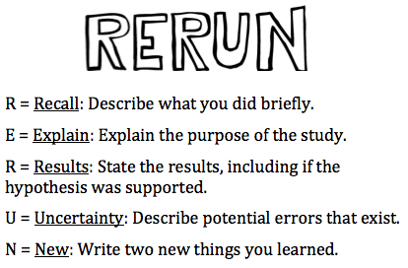
Ms. Northrup’s grading
Balloon Conclusion
Individual grades out of 100
Each part of RERUN is worth 20 points
Overall I was happy with the progress
If you wish to resubmit, need to come to tutoring

Slide 11
Ms. Northrup’s grading
Class Work with the Substitute
Vocabulary will not be graded this UNIT
From what I saw I was very impressed
I looked @ Graphing practice
This will be a skill we aim to improve
Please put Vocabulary, Graphing Foldable, & Graphing Practice into your binder for future reference

Slide 12
10 mins for Housekeeping
Opportunity to get graded work returned
Organize your binder
Ms. Northrup will be coming through for binder check
Stay seated, talk quietly
phones allowed but no headphones
I will take individual questions about grading @ the end of class & @ tutoring.

Slide 13
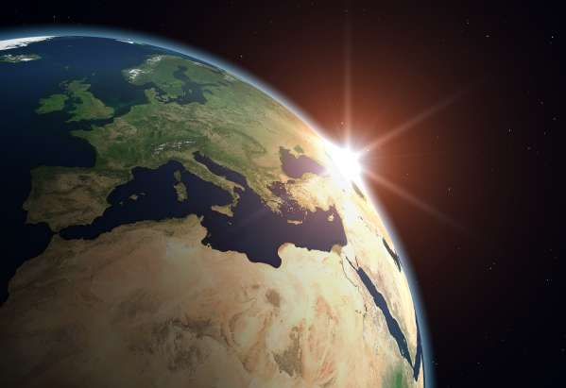
Barycenter Lab Clear your desk

Slide 14
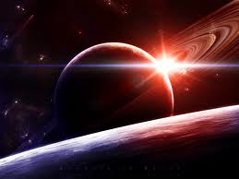
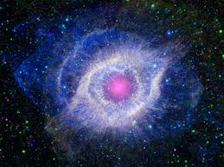
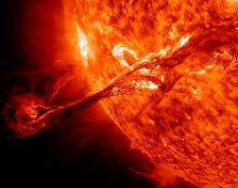
Expectations:
Stay seated, heads up
No talking
Raise your hand
No bathroom passes

Slide 15
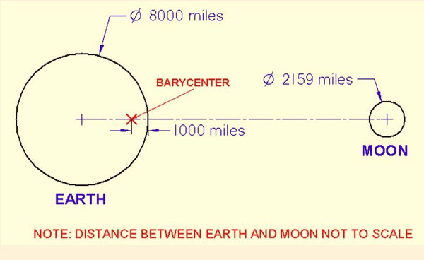
The Barycenter
The Barycenter is the center of mass between two objects orbiting each other.
http://www.youtube.com/watch?v=1iSR3Yw6FXo
Notes:
Use a baseball bat to show center of gravity

Slide 16
Definition of Barycenter
The point between two objects where they balance each other
When a moon orbits a planet, or a planet orbits a star, both bodies are actually orbiting around a point that lies outside the center of the primary (the larger body)

Slide 17
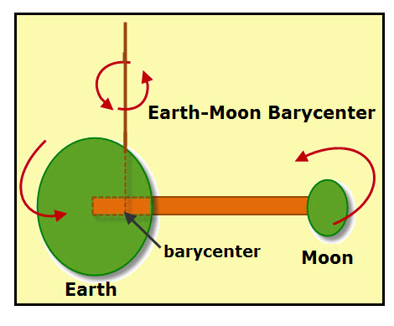
Example
The moon does not orbit the exact center of the Earth, but a point on a line between the Earth and the Moon approximately 1,710 km below the surface of the Earth, where their respective masses balance.

Slide 18
Barycenter Lab
This is a hands-on activity to help you understand Barycenter
You are working in tripod (2 other students)
SWBAT determine the barycenter between two objects
Three parts:
Research
Data collection
Data Interpretation

Slide 19
Barycenter Lab
Expectations:
You are following the procedure exactly as it says
This is why we studied the importance of procedures*
Do not get up out of your seat unless authorized
Talk quietly with only your partners
You have the thirty minutes to finish the lab
Including data collection & comprehension questions
If you finish early, clean up & work on CROSSWORD

Slide 20
Lets look @ procedure
Read for thirty seconds
Turn and summarize with partner

Slide 21
What should the classroom look like...
During a lab?
During partner work?

Slide 22
What should the classroom look like?
Everyone facing the board
Only 2 students per table
Stay seated (safety)
Talking quietly with peers near you
Cooperatively sharing materials

Slide 23
What should the classroom look like?
Everyone facing the board, Stay seated (safety)
Talking quietly with your Tripod only
Cooperatively working together
Forty minutes to finish lab
Including data collection & comprehension questions
If you finish early, clean up (put materials in bag)

Slide 24
Conclusion Paragraph
I will help you with this
NO Talking
Listening & raising hands

Slide 25
RERUN
Recall what you did!
What was your PROCEDURE?
What physical ACTIONS did you do?
EX- Using the materials, my group and I placed two different sized spheres on the end of a dowel rod. Using a string we tried to balance the two spheres.

Slide 26
RERUN
Explain your purpose
Connect to OBJECTIVE + Astronomy
EX- We did this lab to better understand the center of mass between two orbiting objects. For instance, the earth and the moon have a barycenter. The barycenter is located...

Slide 27
RERUN
Results
What was your hypothesis??
If “sphere 1” is heavier than “sphere 2,” then I predict the barycenter will be closer to _____.
EX- I can accept my hypothesis because the barycenter was located closer to... This connects to real life because....

Slide 28
RERUN
Uncertainity
Error
When did you not follow the procedure word for work?
EX- A potential error in my experiment could be when we...

Slide 29
RERUN
NEW
Connect to astronomy
What did you learn about barycenter?
EX- From this lab I learned....
This lab reminds me of our astronomy objective because I learned....

Slide 30
After the LAB
1- clean up, 2- questions, 3- conclusion PARAGRAPH
Talk quietly, remain seated, face forward

Slide 31
Exit Ticket
CLEAR YOUR DESK
Need a half sheet of paper
Put in EXIT TICket box @ bell

Slide 32
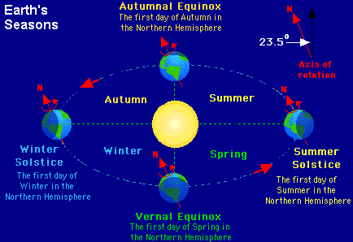

Slide 33
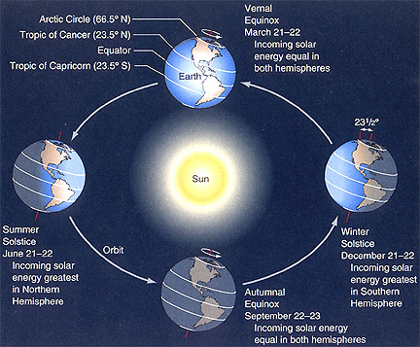

Slide 34
Exit Ticket – fill in the blank
Earth ______ around the sun
_______ turns solar radiation into chemical energy.
Earth orbits the sun in an ________ shape.
The earth’s ______ causes seasons.
The maximum _______ to the sun causes the summer and winter solstice.

