Slide 1
Comprehension!
Objective
Agenda
SWBAT use Rock Cycle model to answer analytical questions
Homework:
Rock Cycle Model
Due: Wednesday – 9/24
Rock Cycle Questions
Due: Thursday– 9/25
Warm Up
Objective
Project Expectations
Independent Work Time
Review Yesterday’s exit ticket
Exit Quiz

Slide 2
How does erosion differ from weathering?
Weathering BREAKS DOWN the Earth’s material into sediments.
Where as, erosion TRANSPORTS the sediments to a new location.

Slide 3
Take Learning into Your Own Hands
5 days of new material
Time for you to become 100% confident in content
Similar to Astronomy Book
Create a model, book, diagram
How all the vocabulary is connected

Slide 4
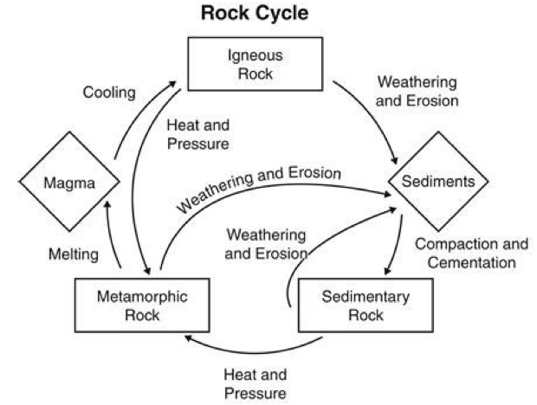
Different Images to represent Cycle

Slide 5
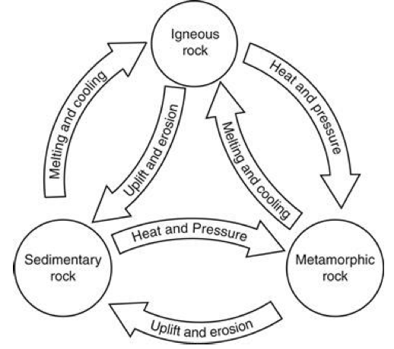
Different Images to represent Cycle

Slide 6
Not only Images
But annotated images
Each vocabulary word needs to be explained
Make the definitions in your own words
Thinking, NOT just copying
If I were to allow you to use this on the exam, what would you want it to look like?

Slide 7
We have Resources
Guided Notes
Textbook
Rocks
PPTs
Vocabulary Sheets
Internet (age of information)

Slide 8
Dedicated to drawings of the rock cycle (10)
Method of formation for each rock:
Specific characteristics of each rock:
Metamorphic (10)
Foliation
Igneous (10)
Extrusive
Intrusive
Sedimentary (10)
Clastic
Chemical
Use real life rocks as examples
Sketch our sample rocks

Slide 9
Erosion
How erosion happens via:
Water (5)
Wind (5)
Glaciers (5)
Gravity (5)
Real life examples, climate, types of rocks it affects most,

Slide 10
dedicated to defining weathering (10)
How weathering happens via:
Mechanical & Examples (10)
Biological Activity
Frost Wedging
Unloading
Chemical & Examples (10)
Water
Oxidation
Acid Rain

